Slide 1
Secure an API by requiring API keys
Try to call the API
Now try to call your API proxy:
http://{org-name}-test.apigee.net/helloapikey
replacing {org-name} with the name of your Edge organization.
Without the Verify API Key policy, this call would give you the same response as the previous call. But in this case, you should get the following error response:
{"fault":{"faultstring":"Failed to resolve API Key variable request.queryparam.apikey","detail":{"errorcode":"steps.oauth.v2.FailedToResolveAPIKey"}}}

Slide 2
Secure an API by requiring API keys
About the API product
An API product in Edge (among other nifty features) generates API keys for developers; or more accurately, for the apps developers register with Edge.
If you're curious, you can view the API product that was automatically created when your API proxy was generated. Select Publish > API Products > helloworld_apikey-Product in the UI.
Notice that the Key Approval Type is Automatic. That means developers get an API key automatically when they register an app, as opposed to you manually approving keys before they're given to developers.

Slide 3
Secure an API by requiring API keys
Add a developer and app to your organization
Create a developer
To create a developer:
Select Publish > Developers in the menu.
Click + Developer.
In this field | enter
First Name | Keyser
Last Name | Soze
Username | keyser
Email | keyser@example.com

Slide 4
Secure an API by requiring API keys
Register an app
To register a developer app:
Select Publish > Apps.
Click + App.
Enter the following in the New Developer App window:
In this field | do this
Name and Display Name | Enter: keyser_app
Developer | Select: Keyser Soze (keyser@example.com)
Callback URL and Notes | Leave blank

Slide 5
Secure an API by requiring API keys
Under Products, click + Product.
Select helloworld_apikey-Product.
Click Save.

Slide 6
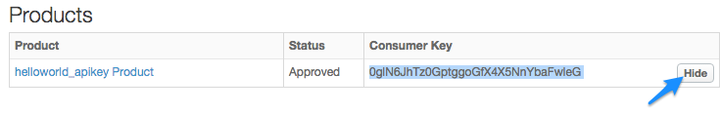
Secure an API by requiring API keys
Get the API key
To get the API key:
On the Apps page (Publish > Apps), click keyser_app.
On the keyser_app page, click Show in the Consumer Key column. Notice that the key is associated with the "helloworld_apikey Product". Click Hide to hide the key.

Slide 7
Secure an API by requiring API keys
Call the API with a key
http://{org-name}-test.apigee.net/helloapikey?apikey=apikey

Slide 8
Secure an API by requiring API keys
Best practice: Passing the key in the HTTP header
Edit the API proxy. Select Develop > API Proxies > helloworld_apikey, and go to the Develop view.
Select the Verify API Key policy, and modify the policy XML to tell the policy to look in the header rather than in the queryparam:
<APIKey ref="request.header.x-apikey"/>
Save the API proxy to deploy the change.
Make the following API call using cURL to pass the API key as a header called x-apikey. Don't forget to substitute your organization name.
curl -v -H "x-apikey: {api_key_goes_here}" http://{org-name}-test.apigee.net/helloapikey

Slide 9
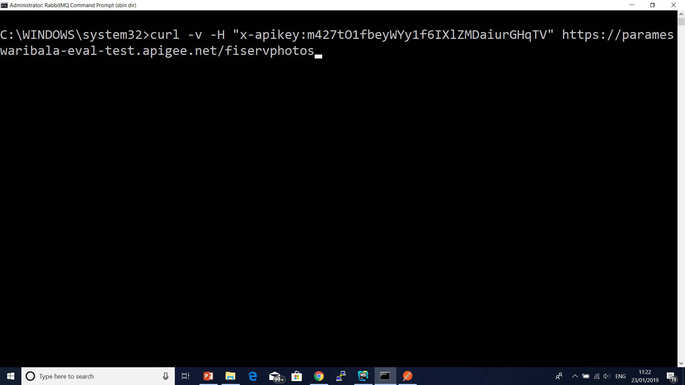
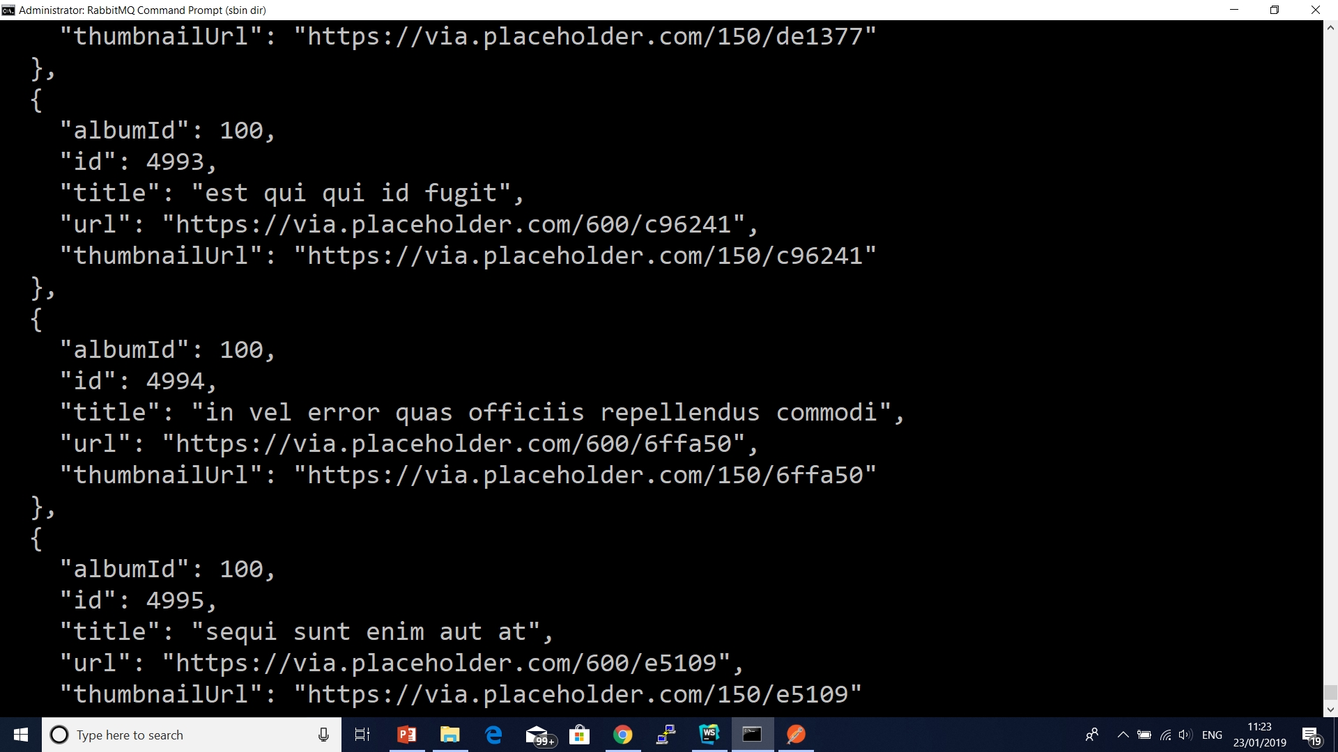
Secure an API by requiring API keys

Slide 10
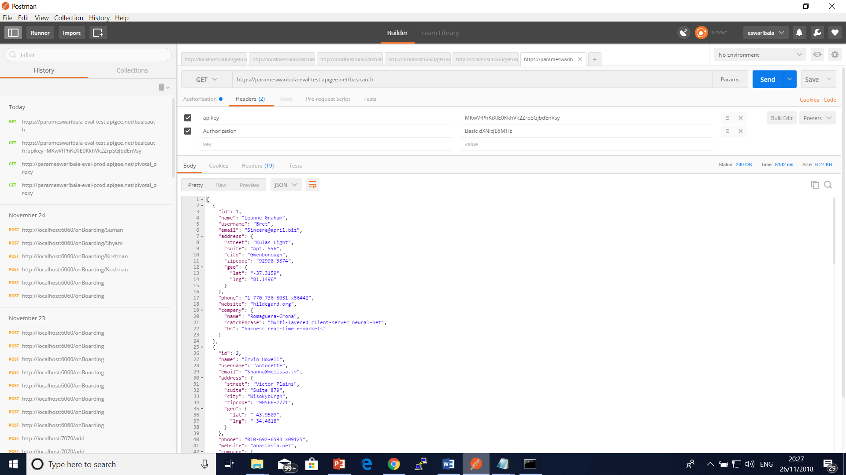
Secure an API by requiring API keys

Slide 11
Download and deploy a token-generating API proxy
In this step, you'll create the API proxy that generates an OAuth access token from a consumer key and consumer secret sent in an API call.
Apigee provides a sample API proxy that does this. You'll download and deploy the proxy now, then use it later in the tutorial. (You could build this API proxy easily yourself. This download and deploy step is for convenience and to show you how easy it is to share proxies that have already been created.)
Download the 'oauth' sample API proxy ZIP file to any directory on your file system.
https://docs.apigee.com/api-platform/tutorials/secure-calls-your-api-through-oauth-20-client-credentials
Go to https://enterprise.apigee.com and log in. This is the Edge management UI.
Click APIs in the top menu.

Slide 12
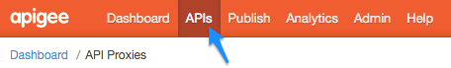
Download and deploy a token-generating API proxy
Click the add (+) API Proxy button.
In the Build a Proxy wizard, select Proxy bundle and click Next.
Choose the oauth.zip file you downloaded, and click Next.
Click Build.
After the build completes, click the oauth link to view the new proxy in the API proxy editor.
On the API Proxy editor Overview page, click the Deployment drop-down and select test. This is the test environment in your organization.

Slide 13
View the OAuth flow and policy
Let's take a closer look at what the API proxy contains.
In the API proxy editor, click the Develop tab. In the left Navigator pane, you'll see two policies. You'll also see two POST flows in the Proxy Endpoints section.
Click AccessTokenClientCredential under Proxy Endpoints.

Slide 14
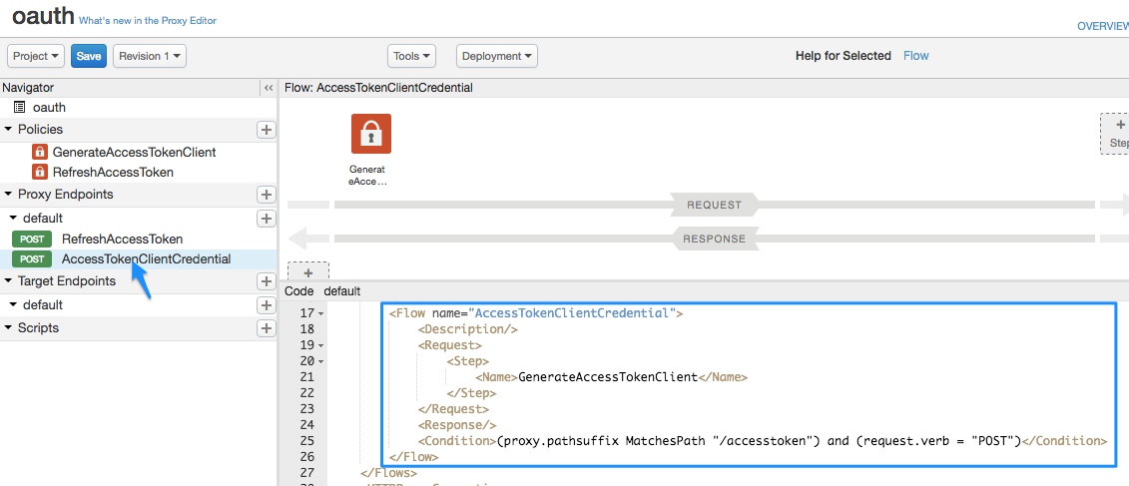
View the OAuth flow and policy

Slide 15
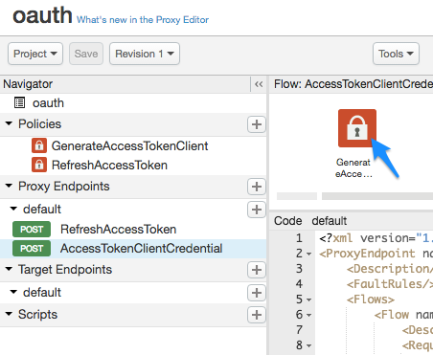
View the OAuth flow and policy
Now let's look at the policy the conditional flow will trigger. Click the GenerateAccessTokenClient policy icon in the flow diagram.

Slide 16
View the OAuth flow and policy
<OAuthV2 name="GenerateAccessTokenClient"> <!-- This policy generates an OAuth 2.0 access token using the client_credentials grant type --> <Operation>GenerateAccessToken</Operation> <!-- This is in millseconds, so expire in an hour --> <ExpiresIn>3600000</ExpiresIn> <SupportedGrantTypes> <!-- This part is very important: most real OAuth 2.0 apps will want to use other grant types. In this case it is important to NOT include the "client_credentials" type because it allows a client to get access to a token with no user authentication --> <GrantType>client_credentials</GrantType> </SupportedGrantTypes> <GrantType>request.queryparam.grant_type</GrantType> <GenerateResponse/> </OAuthV2>

Slide 17
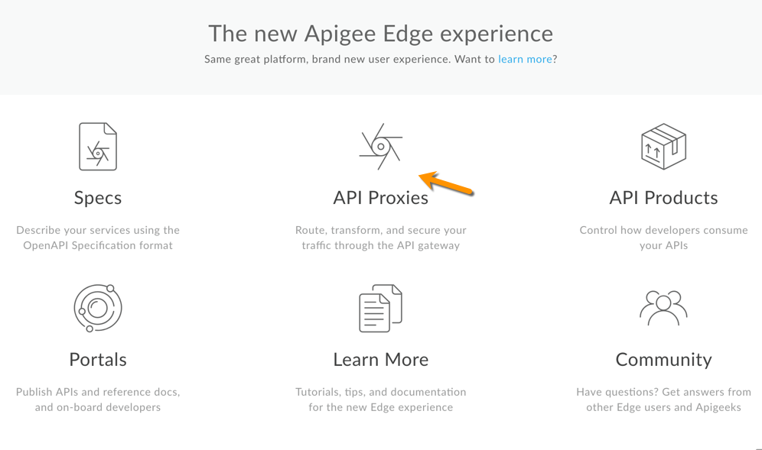
Create the OAuth-protected API proxy

Slide 18
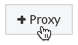
Create the OAuth-protected API proxy
Click + Proxy.
In the Build a Proxy wizard, select Reverse proxy (most common), and click Next.
Configure the proxy as follows:

Slide 19
Create the OAuth-protected API proxy
In this field | do this
Proxy Name | Enter: helloworld_apikey
Project Base Path | Change to: /helloapikey The Project Base Path is part of the URL used to make requests to the API proxy. Note: For Apigee's recommendations on API versioning, see Versioning in the Web API Design: The Missing Link e-book.
Existing API | Enter: http://mocktarget.apigee.net This defines the target URL that Apigee Edge invokes on a request to the API proxy.
Description | Enter: hello world protected by API key

Slide 20
Create the OAuth-protected API proxy
Click Next.
On the Security page:
In this field | do this
Authorization | Select:OAuth 2.0 Publish API Product These options are very handy. They'll automatically add two policies to your API proxy and create an API product.

Slide 21
Create the OAuth-protected API proxy
On the Virtual Hosts page, click Next.
On the Build page, make sure the test environment is selected, and click Build and Deploy.
On the Summary page, you see an acknowledgment that your new API proxy and an API product were created successfully, and that the API proxy was deployed to your test environment.
Click View the helloworld_oauth2 proxy in the editor to display the Overview page for the API proxy. Notice that this time the API proxy is automatically deployed. Click the Deployment drop-down to make sure there's a green deployment dot next to the "test" environment.

Slide 22
View the Policies
In the API proxy editor, click the Develop tab. You'll see that two policies have been added to the request flow of the API proxy:
Verify OAuth v2.0 Access Token – Checks the API call to make sure a valid OAuth token is present.
Remove Header Authorization – An Assign Message policy that removes the access token after it's checked, so that it doesn't get passed to the target service. (If the target service needed the OAuth access token, you wouldn't use this policy).
Click the Verify OAuth v2.0 Access Token icon in the flow view and look at the XML below it in the code pane.

Slide 23
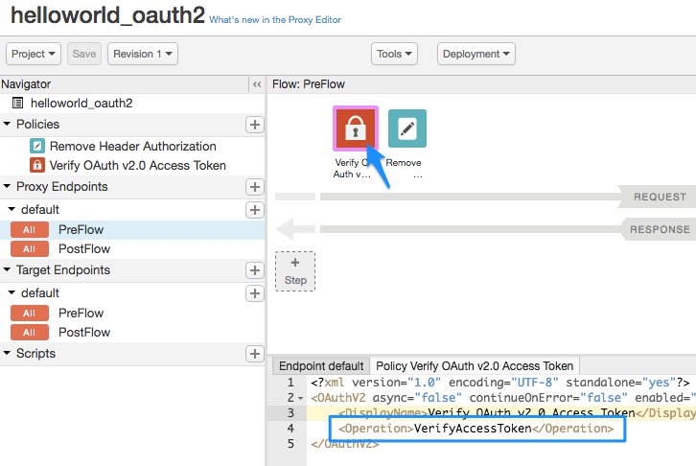
View the Policies

Slide 24
Create the OAuth-protected API proxy
Add a developer and app to your organization
Create a developer
To create a developer:
Select Publish > Developers in the menu.
Click + Developer.
In this field | enter
First Name | Keyser
Last Name | Soze
Username | keyser
Email | keyser@example.com

Slide 25
Create the OAuth-protected API proxy
Register an app
To register a developer app:
Select Publish > Apps.
Click + App.
Enter the following in the New Developer App window:
In this field | do this
Name and Display Name | Enter: keyser_app
Developer | Select: Keyser Soze (keyser@example.com)
Callback URL and Notes | Leave blank

Slide 26
Create the OAuth-protected API proxy
Under Products, click + Product.
Select helloworld_apikey-Product.
Click Save.

Slide 27
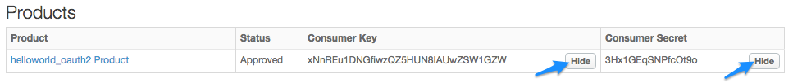
Create the OAuth-protected API proxy
Get the consumer key and consumer secret
Now you'll get the consumer key and consumer secret that will be exchanged for an OAuth access token.
On the Developer Apps page (Publish > Developer Apps), click nigel_app.
On the nigel_app page, click Show in the Consumer Key and Consumer Secret columns. Notice that the key/secret are associated with the "helloworld_oauth2 Product" that was automatically created earlier.
Select and copy the Consumer Key and Consumer Secret. Paste them in a temporary text file. You'll use them in a later step, where you call the API proxy that will exchange these credentials for an OAuth access token.

Slide 28
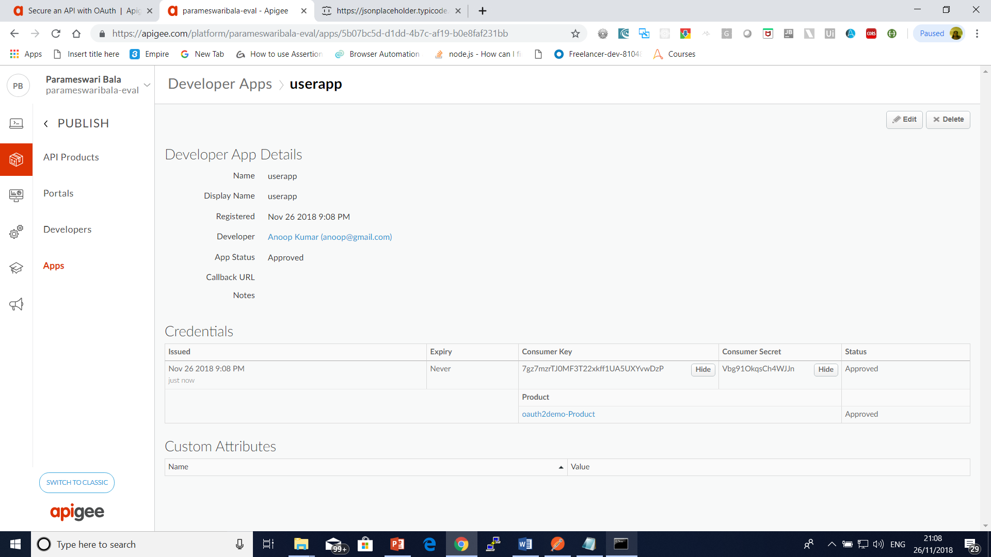

Slide 29
Create the OAuth-protected API proxy
Get an OAuth access token
Now we get to the big payoff. You're about to use the Consumer Key and Consumer Secret you copied and pasted into a text file and exchange them for an OAuth access token. You're now going to make an API call to the API sample proxy you imported, oauth, which will generate an API access token.
Using that key and secret, make the following cURL call (note that the protocol is https), substituting your Edge organization name, your consumer key, and your consumer secret where indicated (be sure to remove the curly braces):
curl -X POST -H "Content-Type: application/x-www-form-urlencoded" \ https://{org-name}-test.apigee.net/oauth/client_credential/accesstoken?grant_type=client_credentials \ -d 'client_id={consumer-key}&client_secret={consumer-secret}'

Slide 30
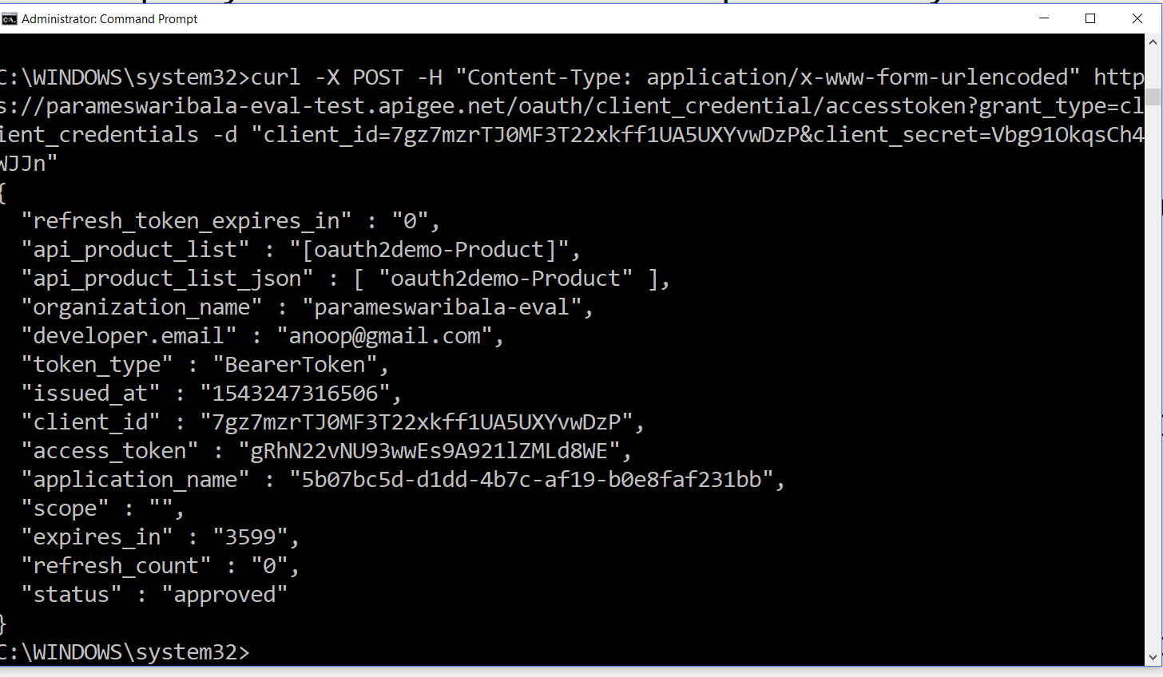

Slide 31
Create the OAuth-protected API proxy
Call the API with an access token (success!)
Now that you have an access token, you can use it to call the API proxy. Make the following cURL call. Substitute your Edge organization name and the access token (remove the curly braces).
curl https://{org-name}-test.apigee.net/hellooauth2 -H "Authorization: Bearer {access-token}"

Slide 32
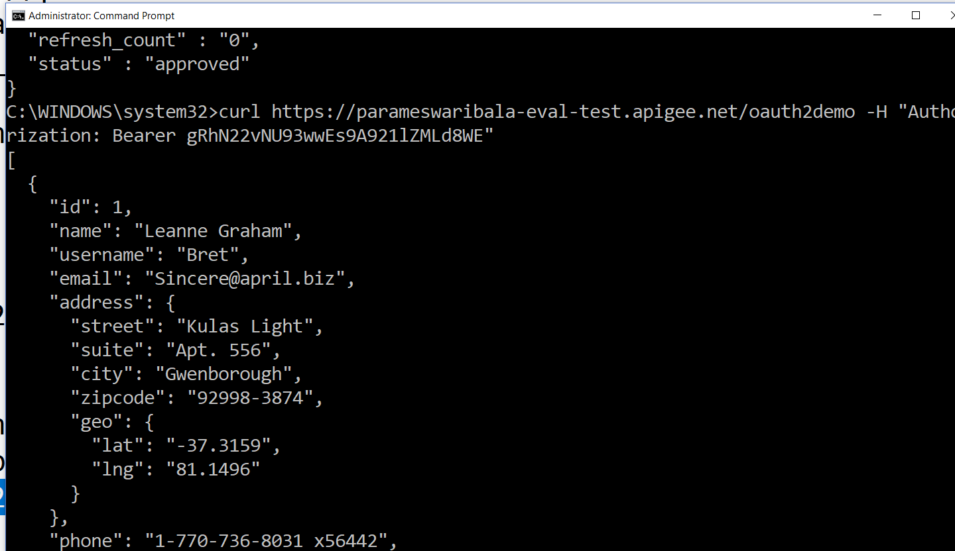

Slide 33
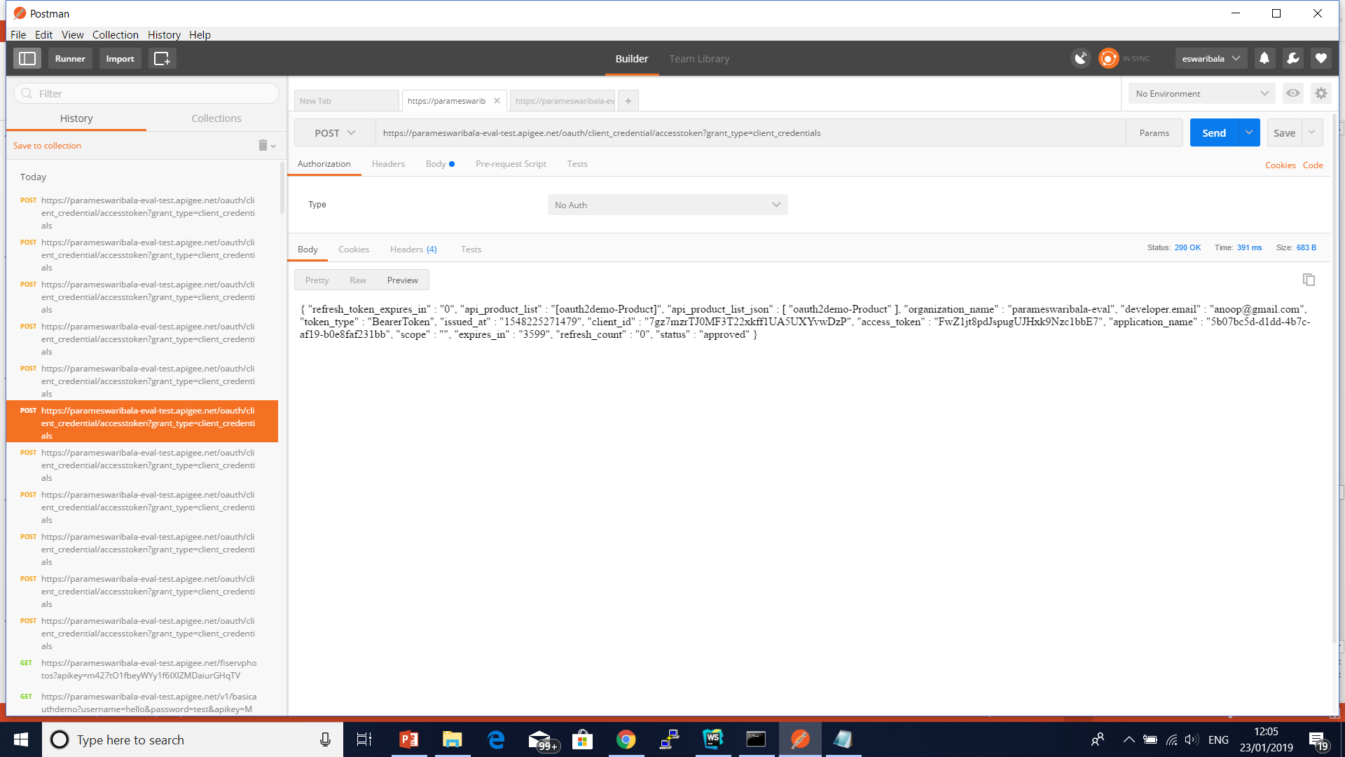
Authorization should be blank

Slide 34
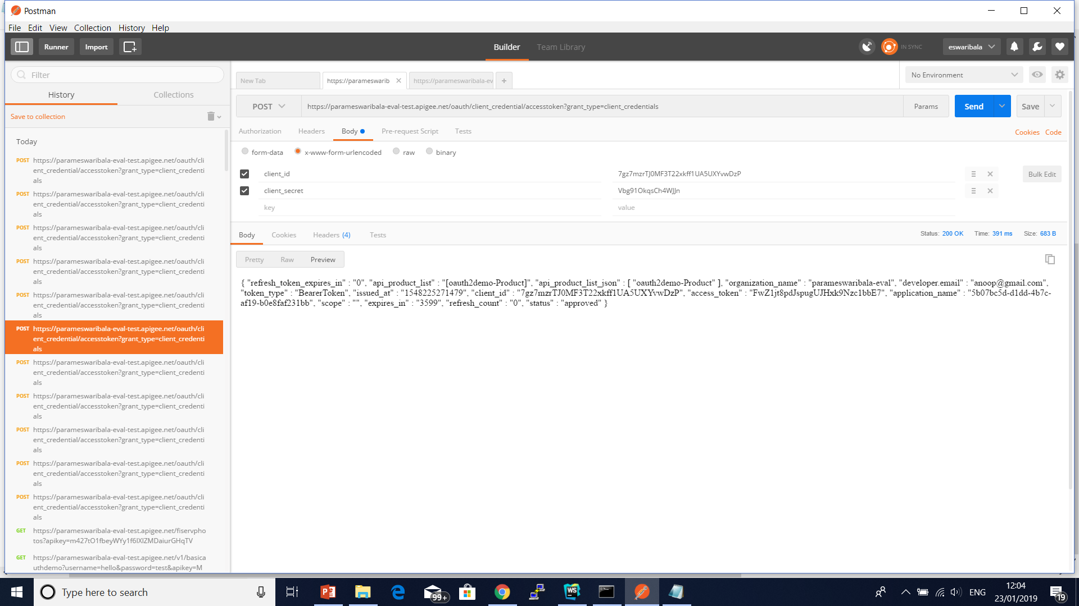

Slide 35
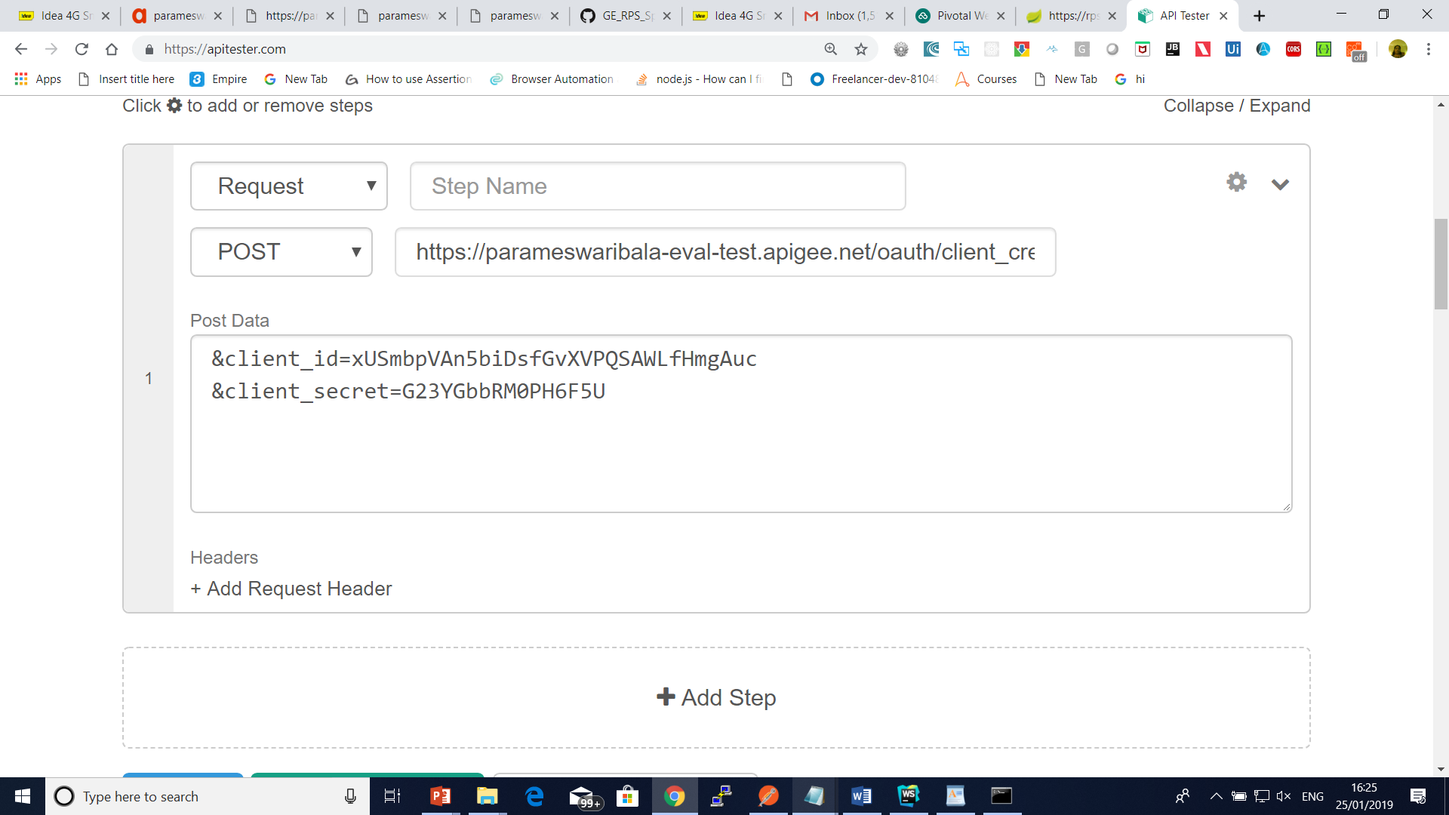
API Tester

Slide 36
Basic Authentication policy
Enables you to use lightweight Basic Authentication for last-mile security.
The policy takes a username and password, Base64 encodes them, and writes the resulting value to a variable.
The resulting value is in the form Basic Base64EncodedString.
You typically write this value to an HTTP header, such as the Authorization header.
The policy also lets you decode credentials stored in a Base64 encoded string into a username and password.

Slide 37
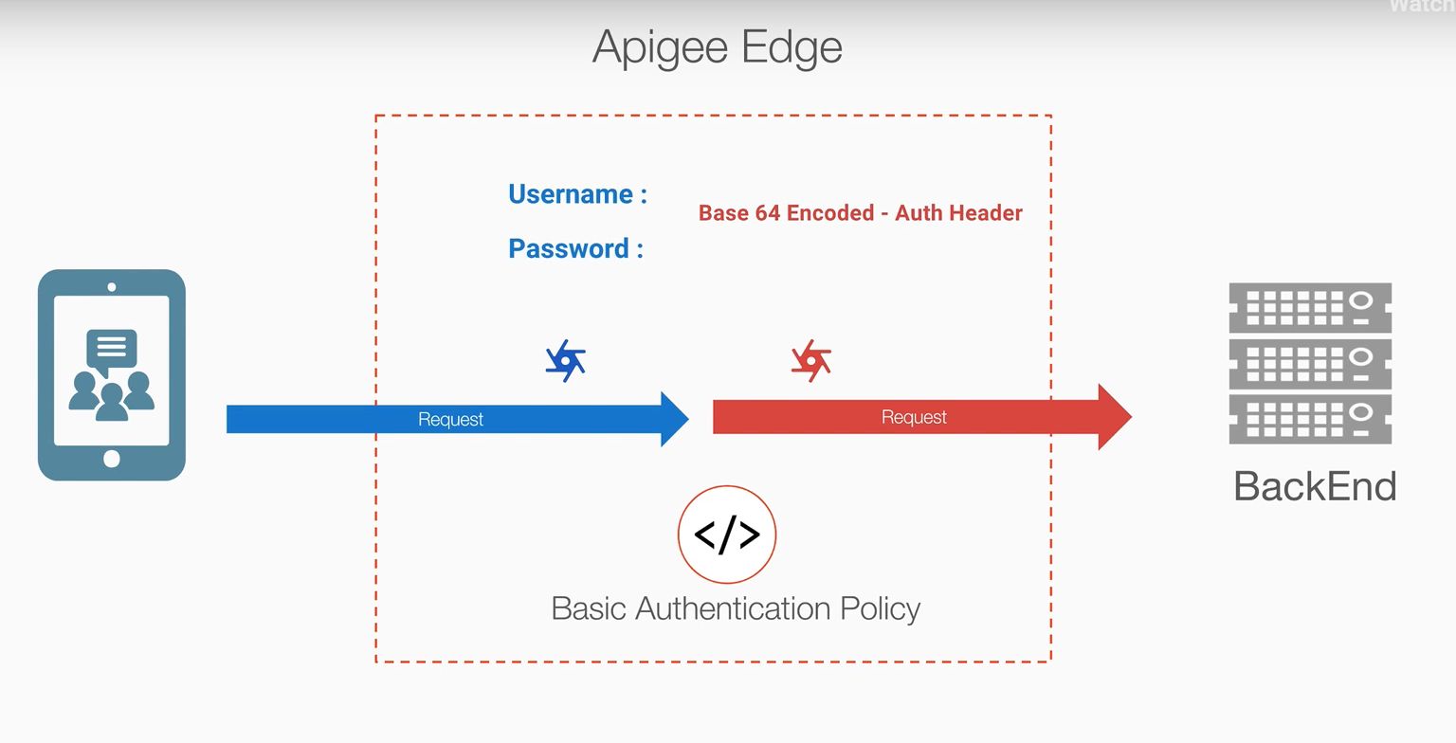

Slide 38
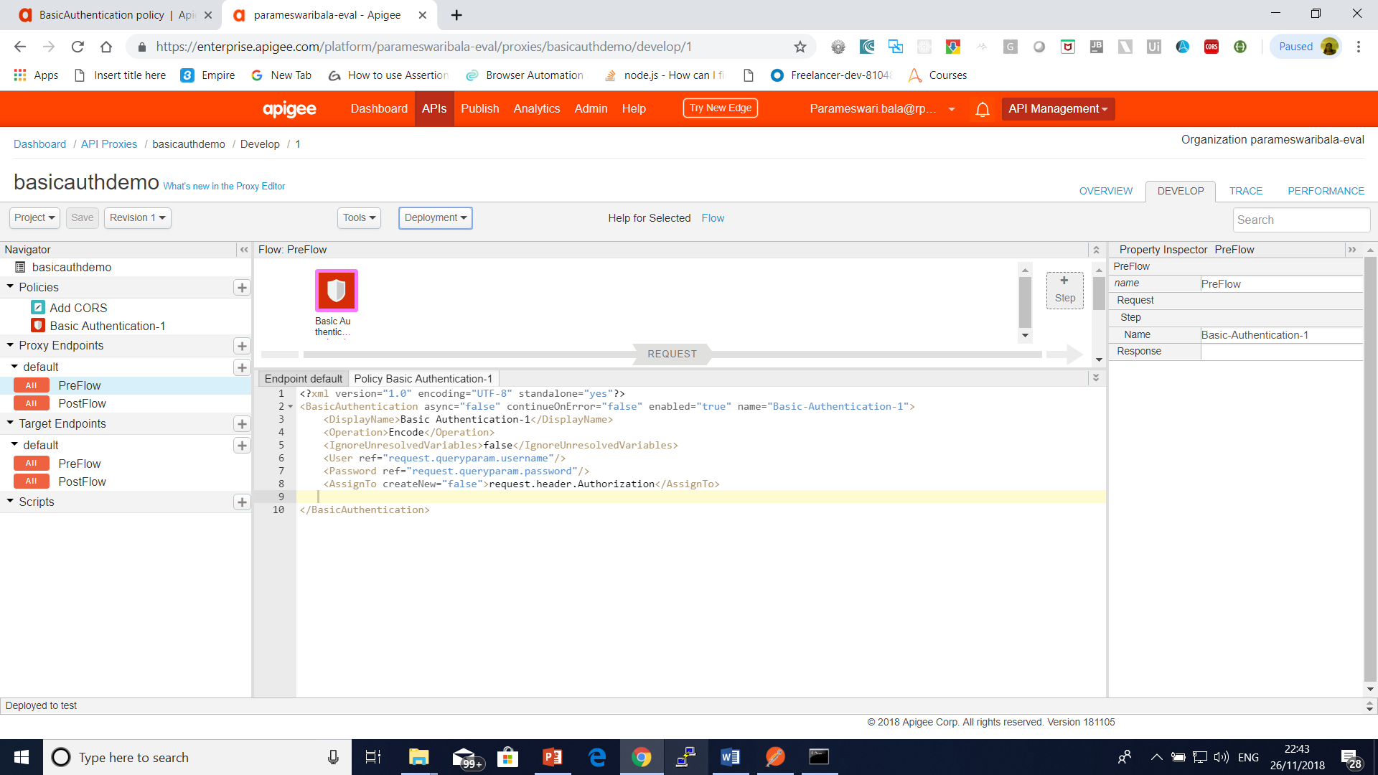
Basic Authentication policy

Slide 39
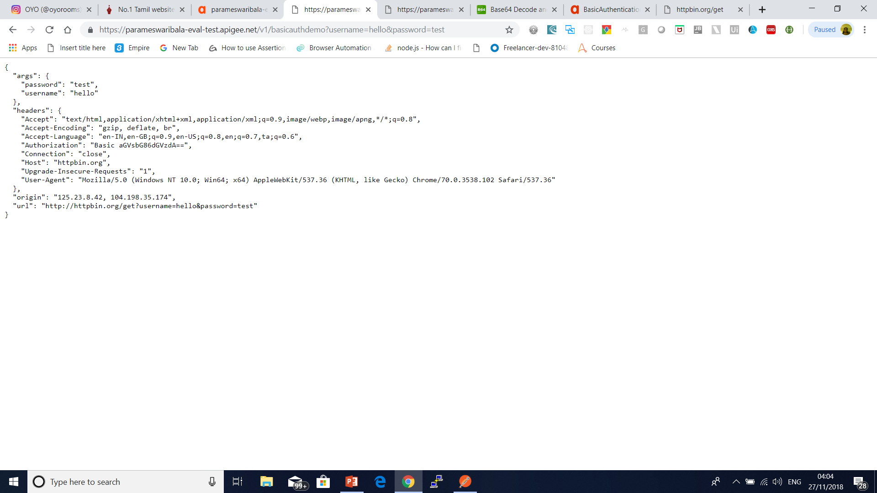
Basic Authentication Policy

Slide 40
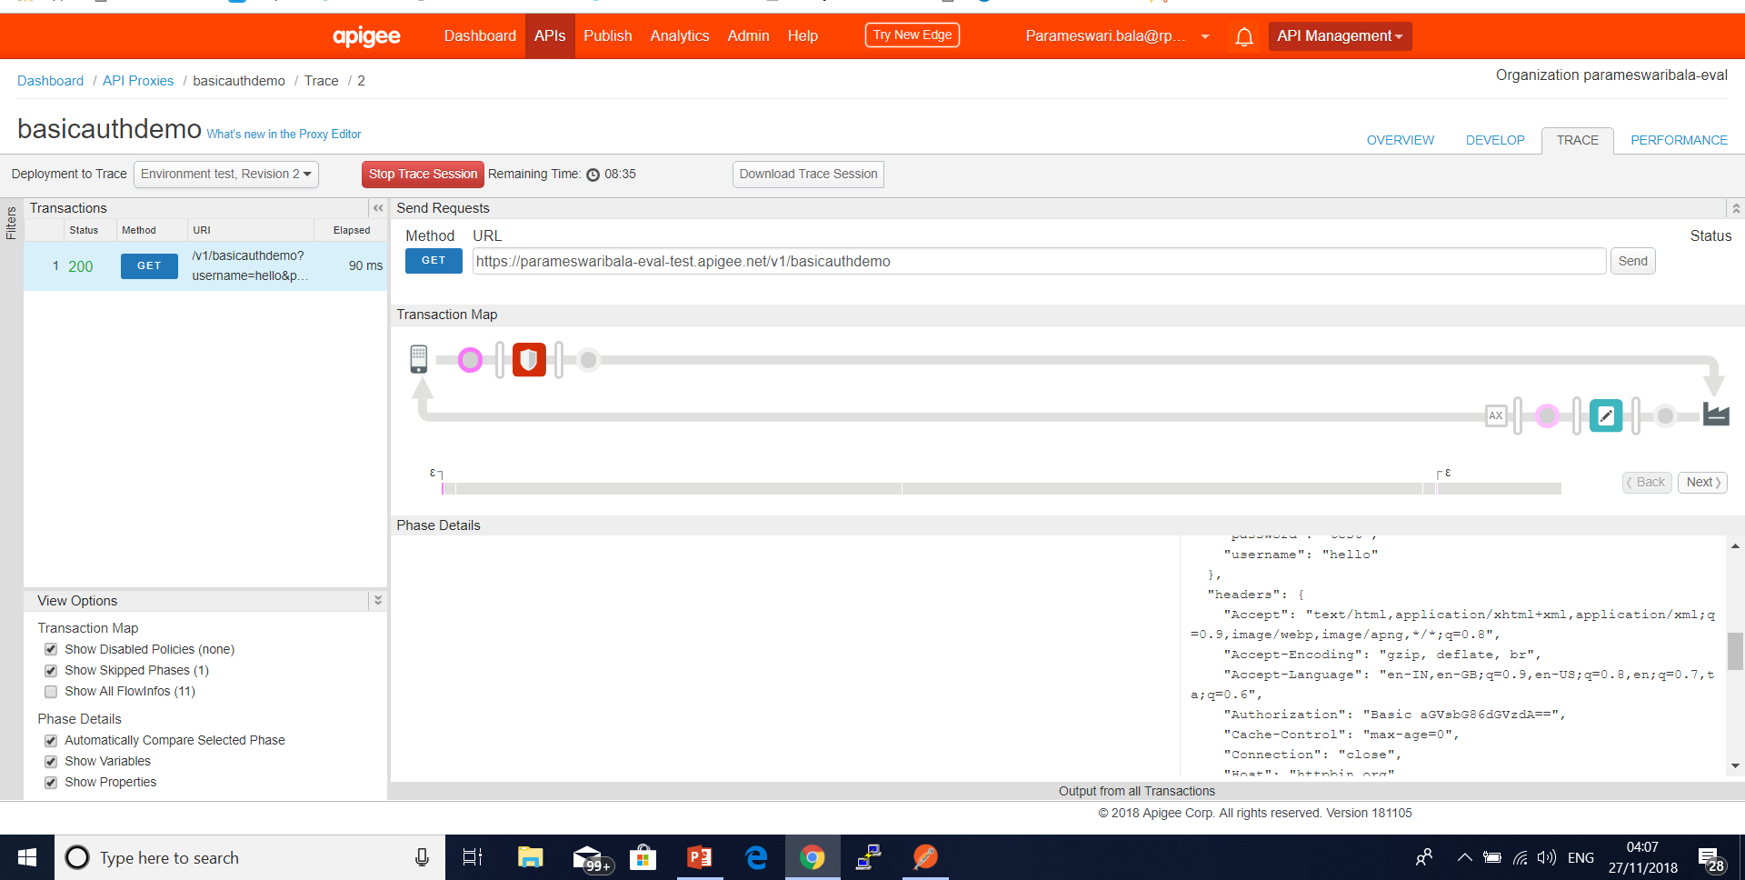
Basic Authentication Policy

Slide 41
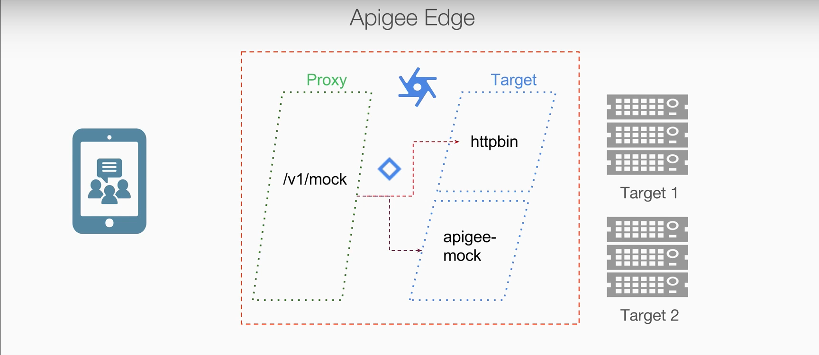
Multiple Endpoints using Routes

Slide 42
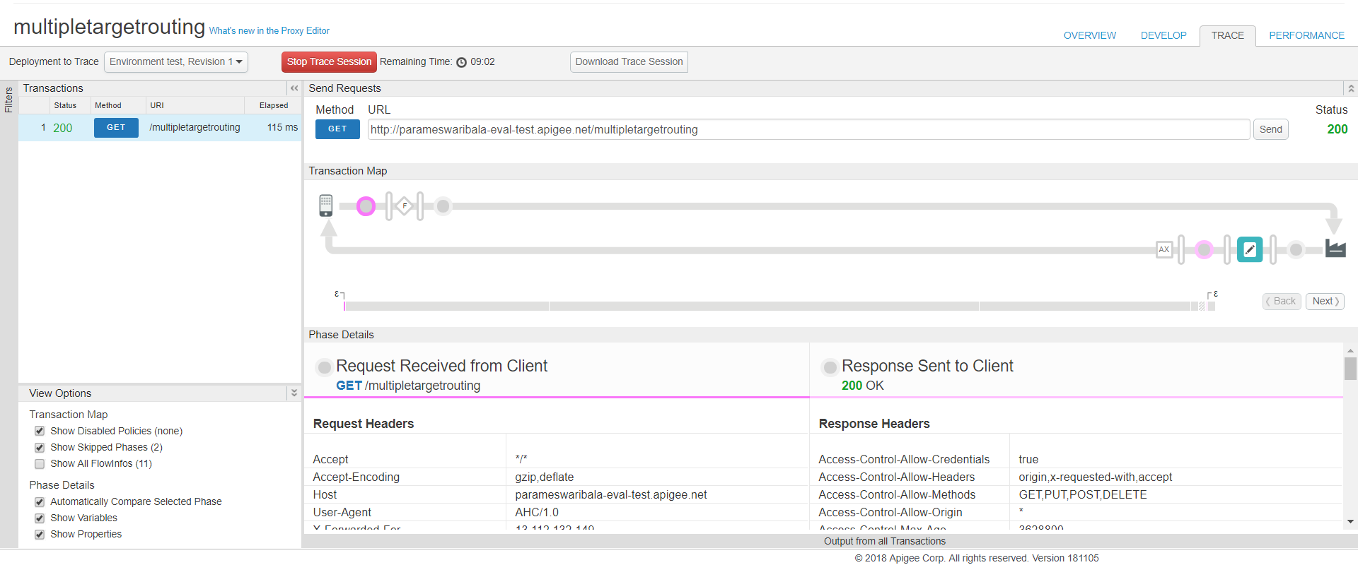
Multiple Endpoints using Routes

Slide 43
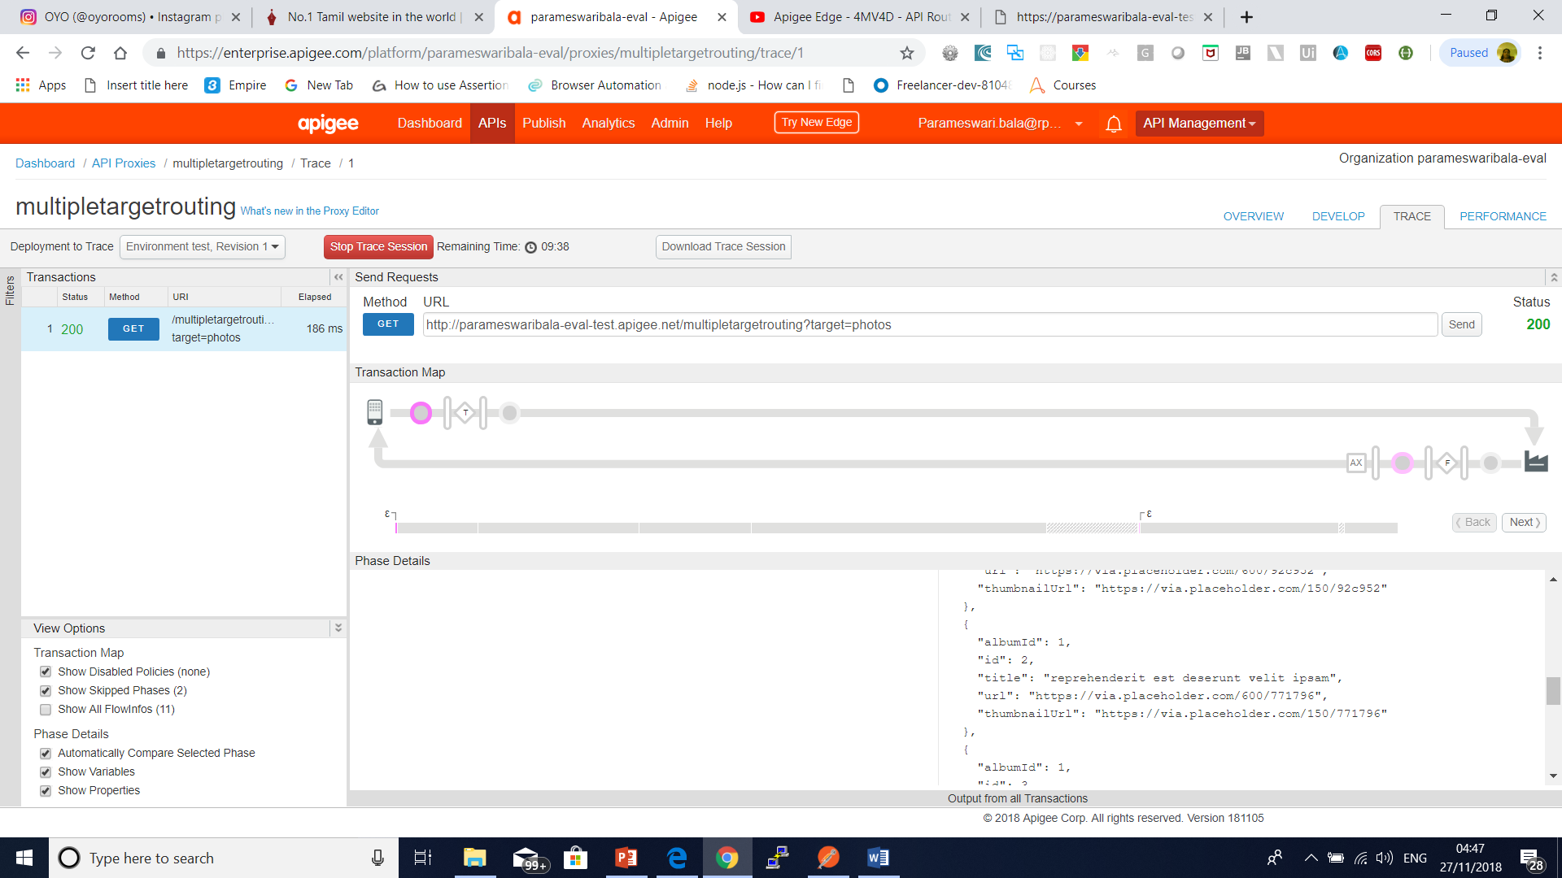
Multiple Endpoints using Routes

Slide 44
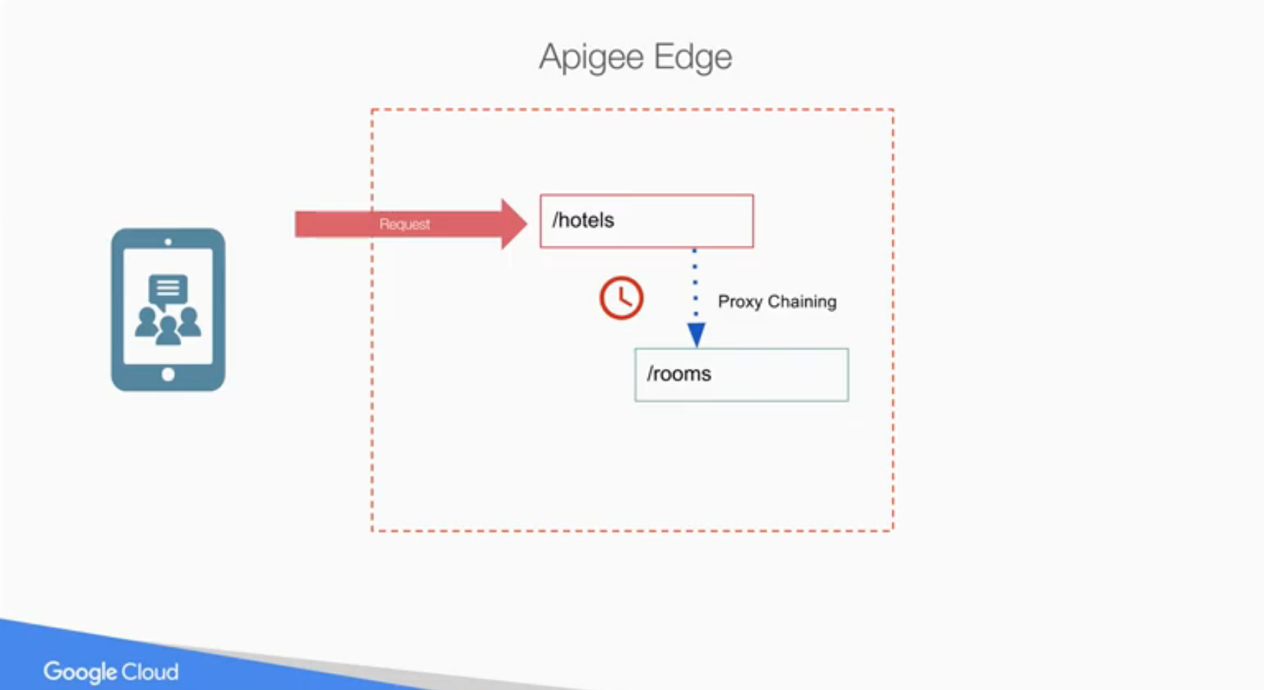
Proxy Chaining

Slide 45
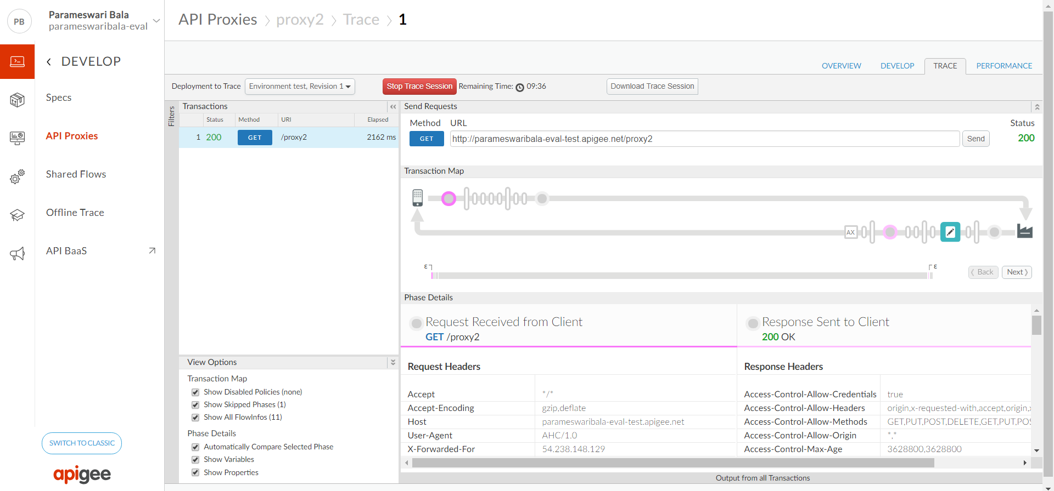
External Proxy Chaining
Proxy 1 -→ Proxy 2

Slide 46
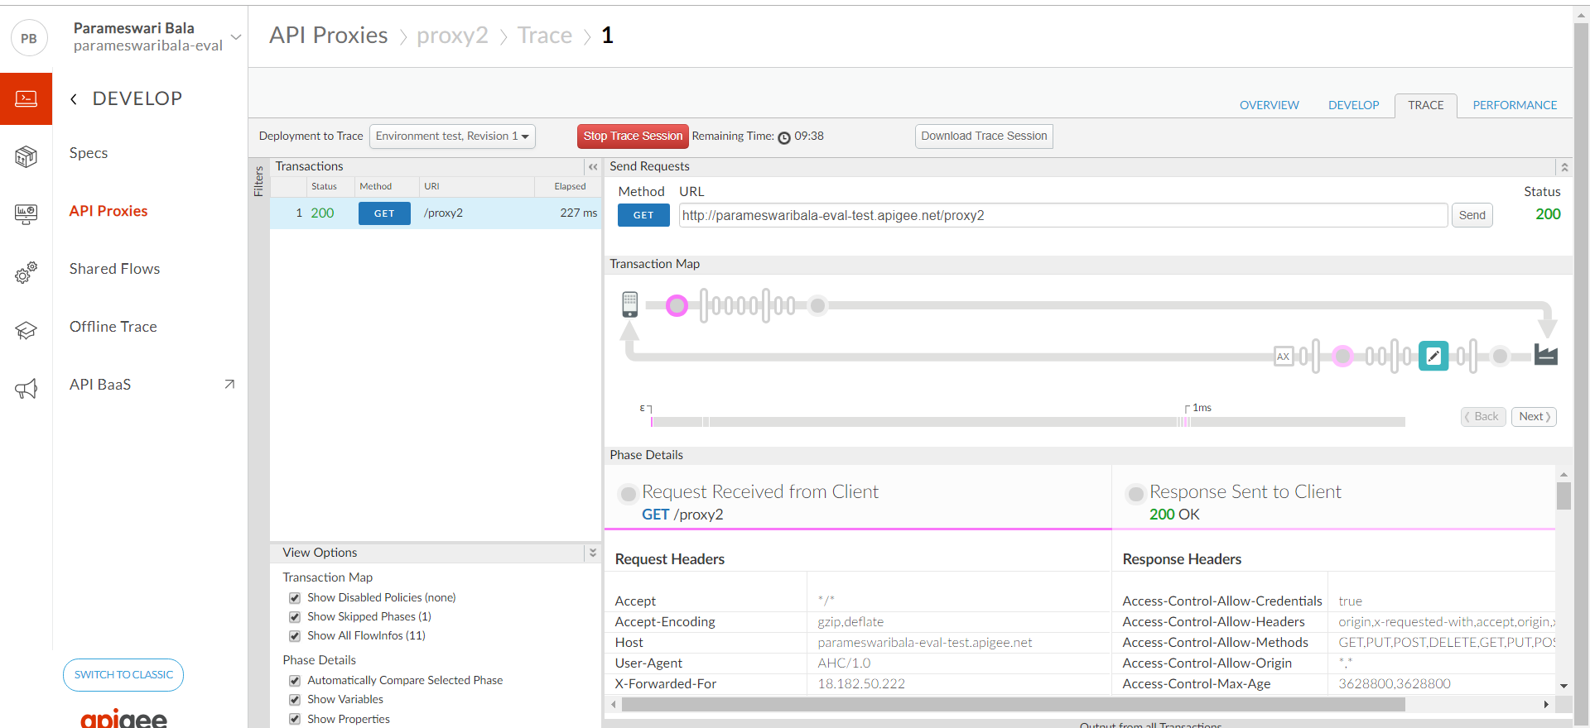
Internal Proxy Chaining
Proxy 1 -→ Proxy 2

Slide 47
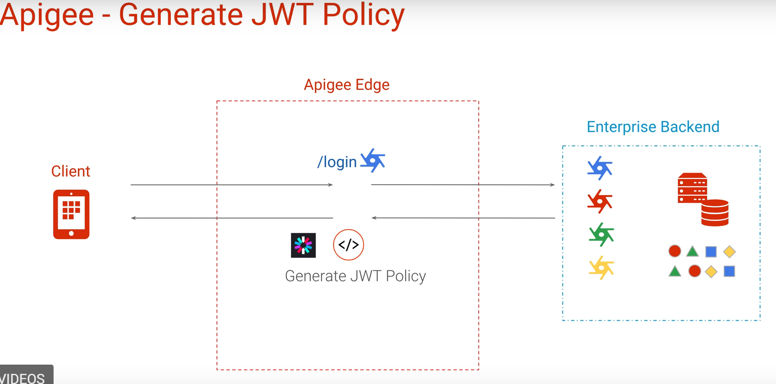
JWT Tokens

Slide 48
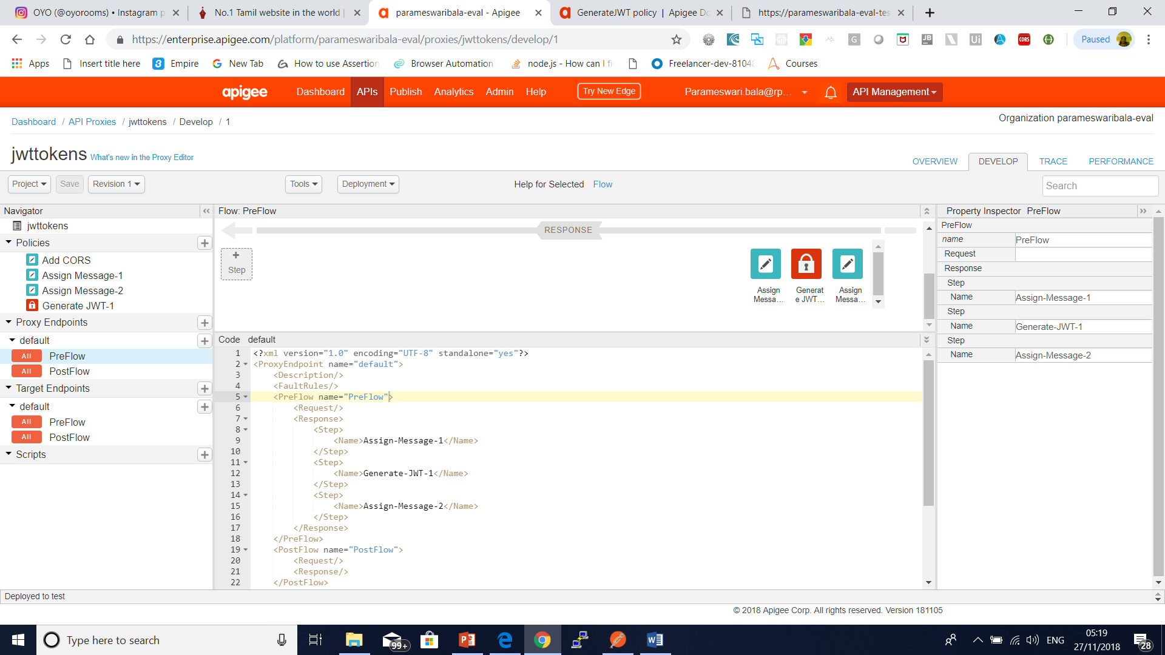
JWT Tokens

Slide 49
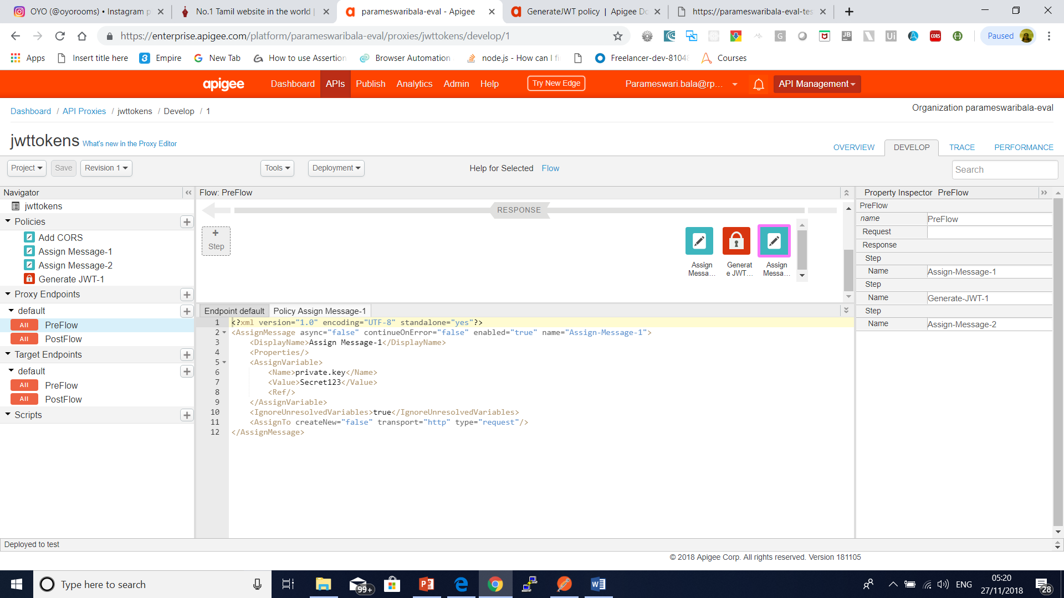
JWT Tokens

Slide 50
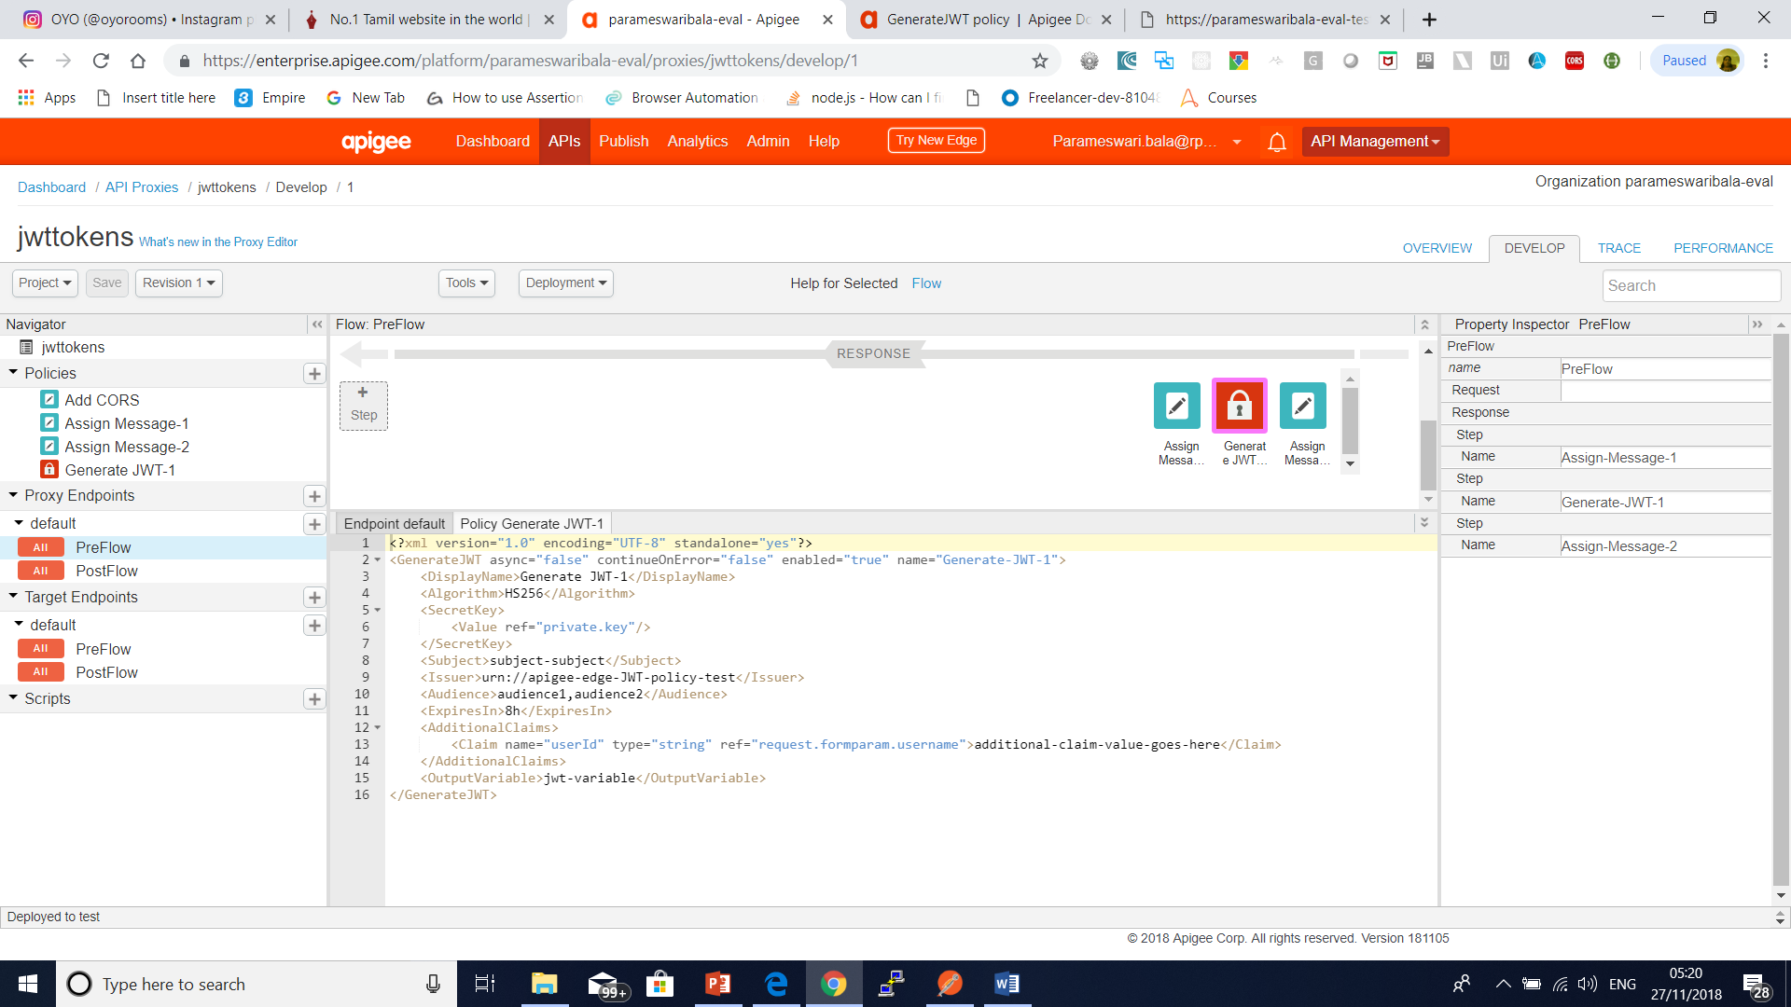
JWT Tokens

Slide 51
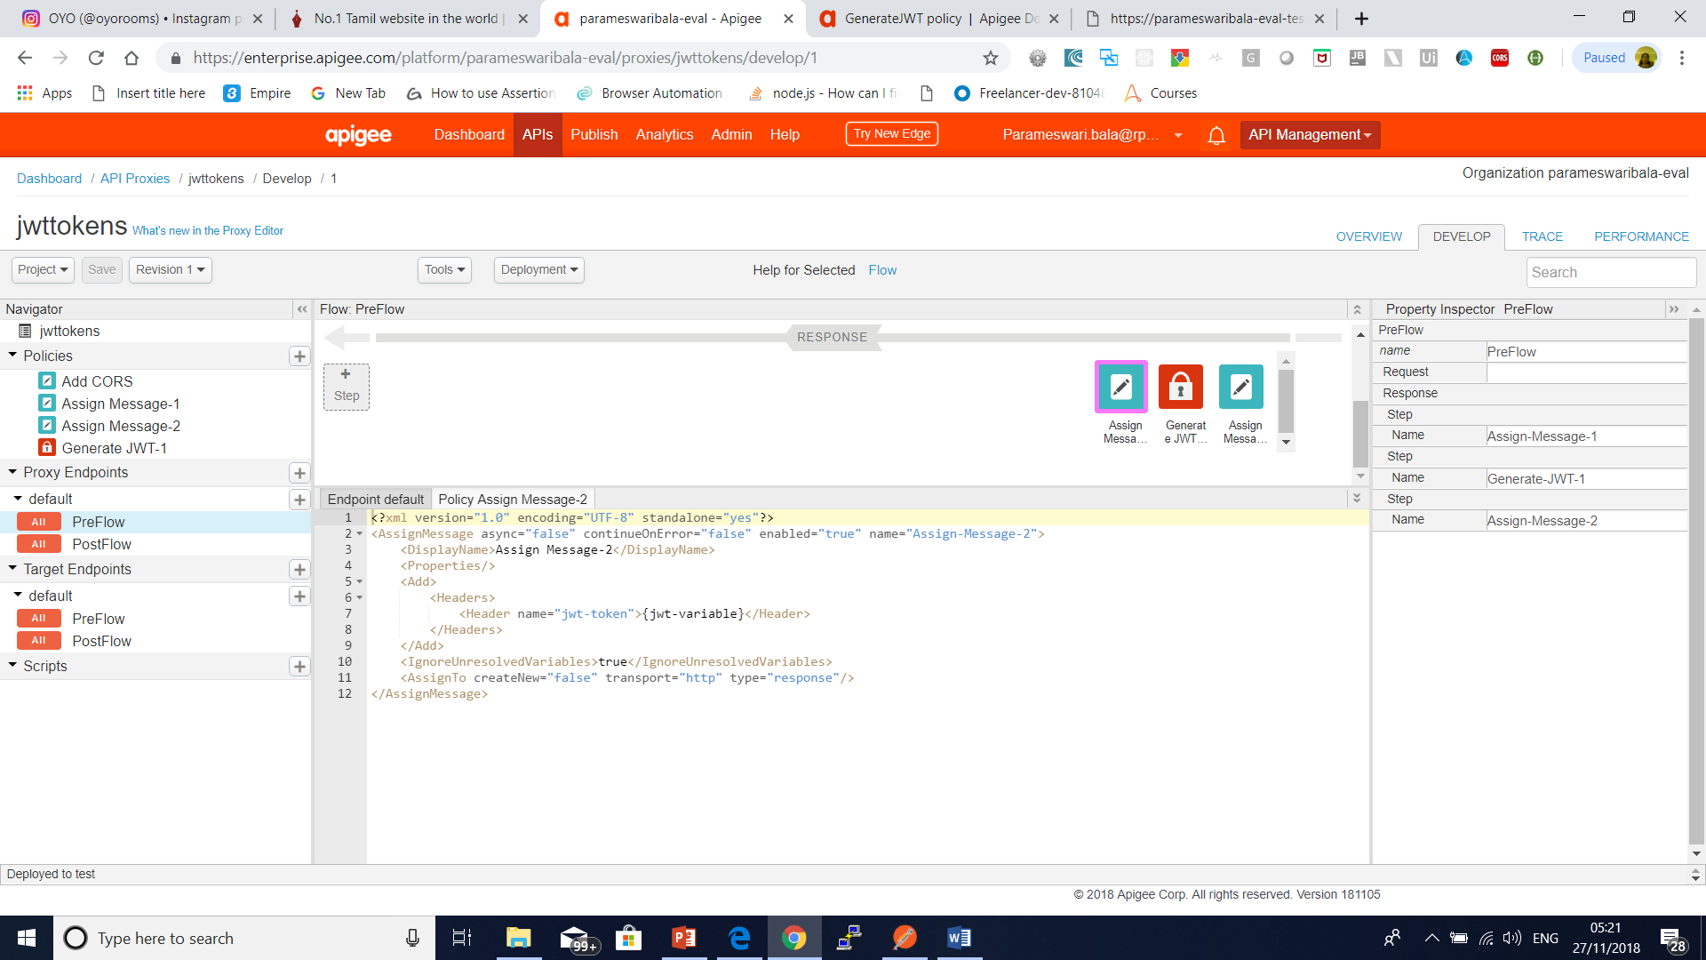
JWT Tokens

Slide 52
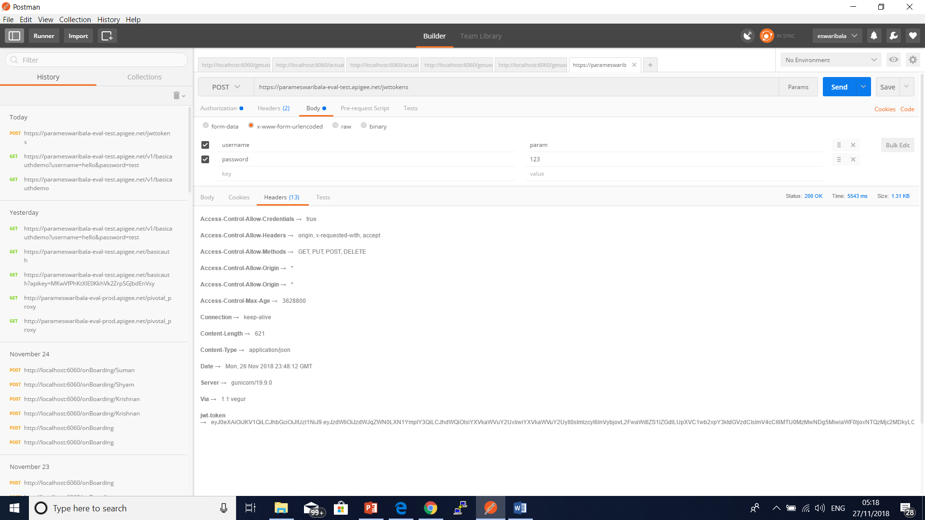
JWT Tokens

Slide 53
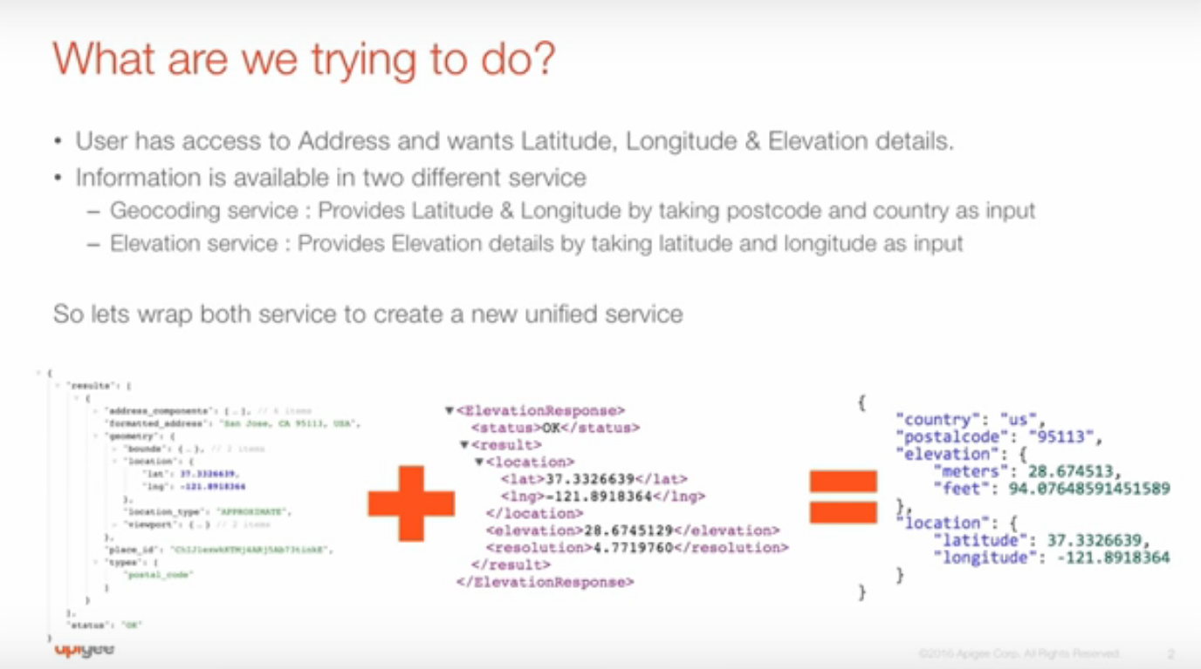
Mashup

Slide 54
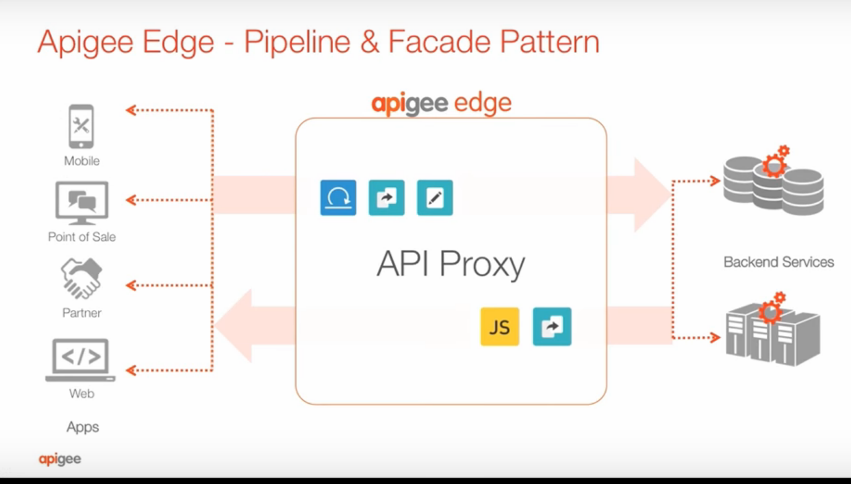
Mashup

Slide 55
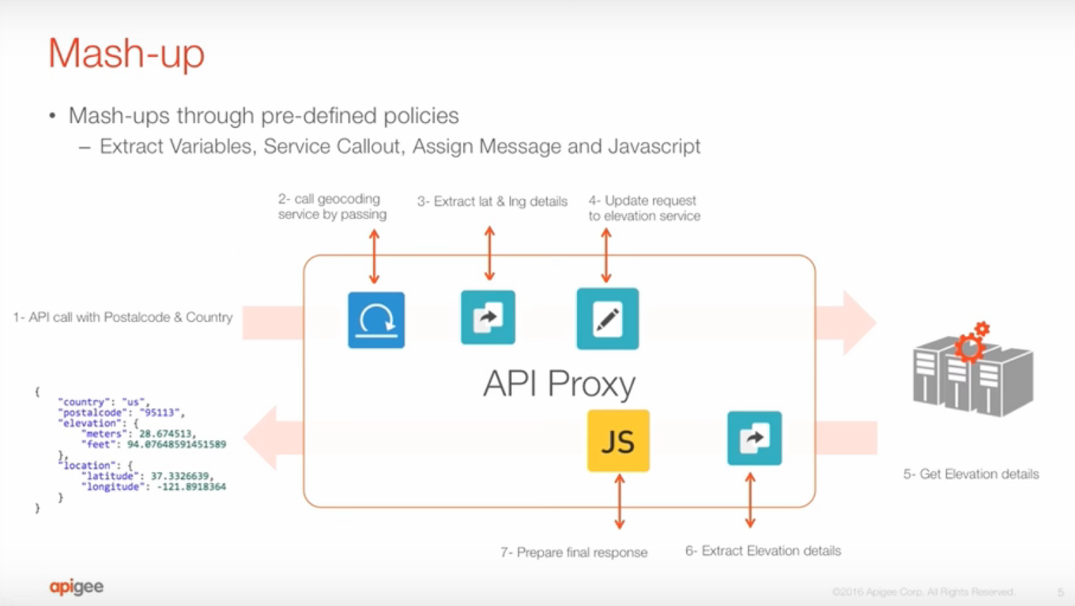
Mashup

Slide 56
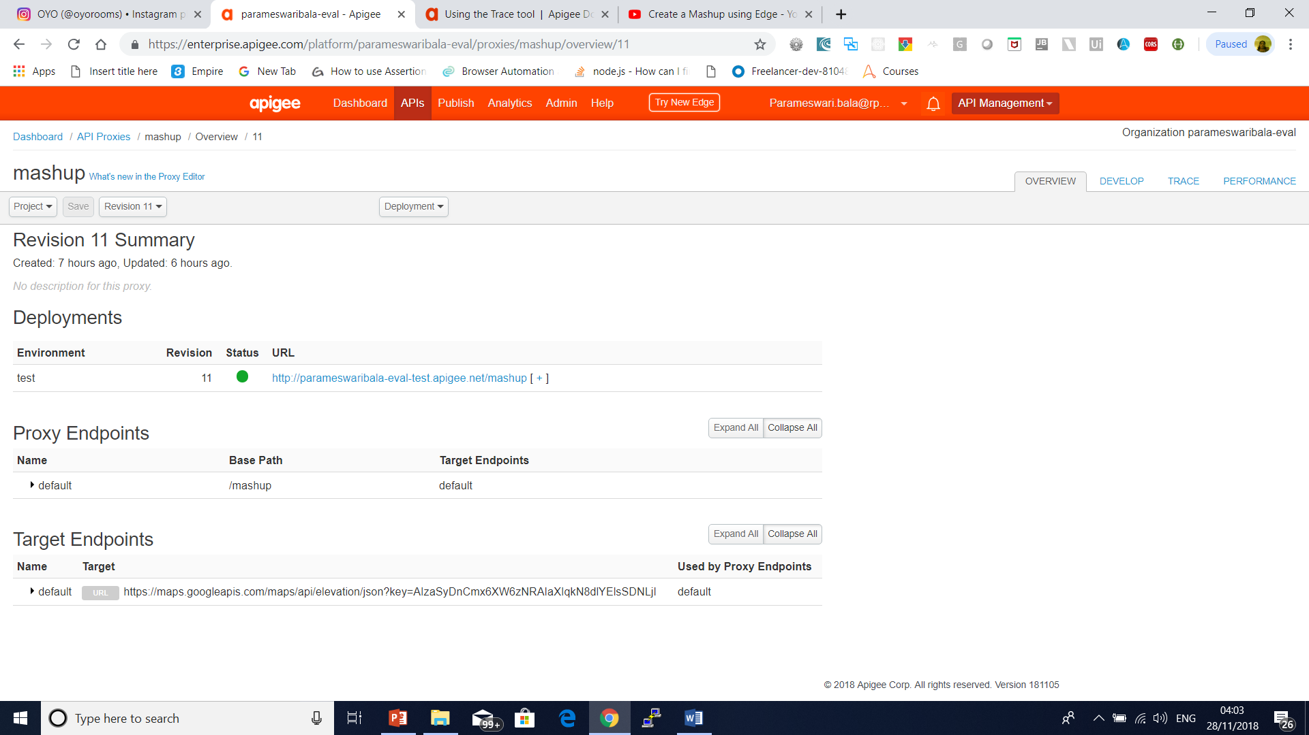
Mashup

Slide 57
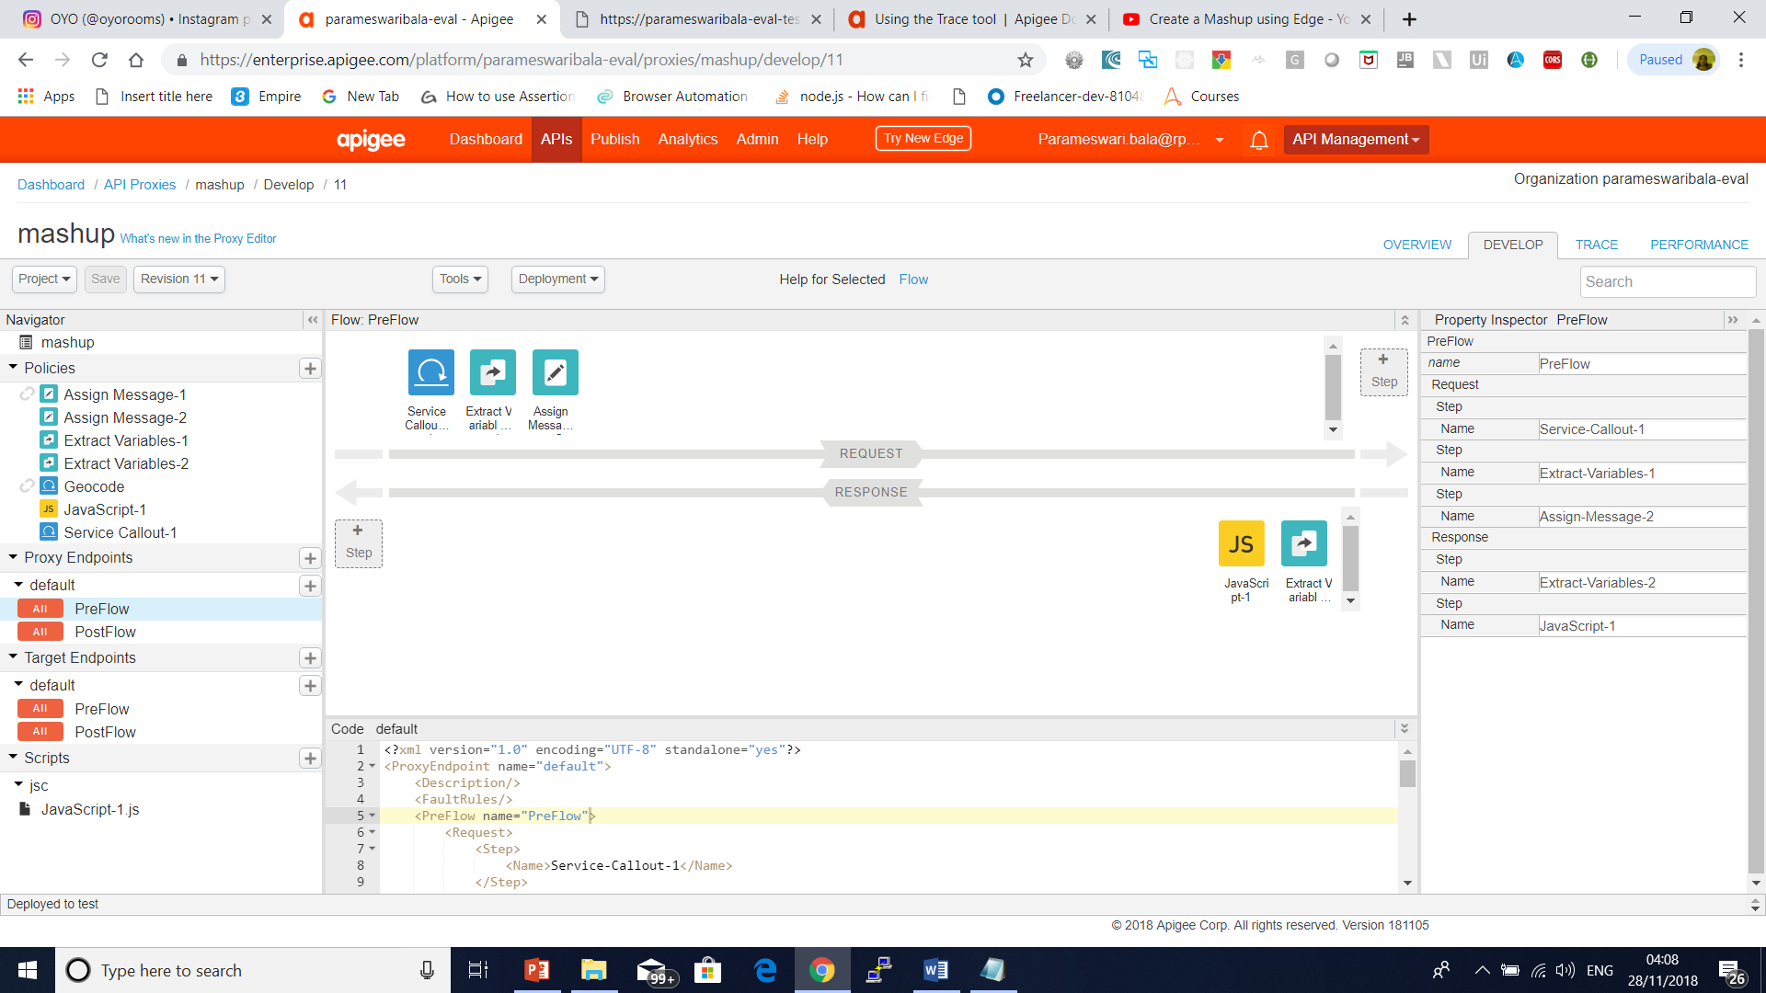
Mashup

Slide 58
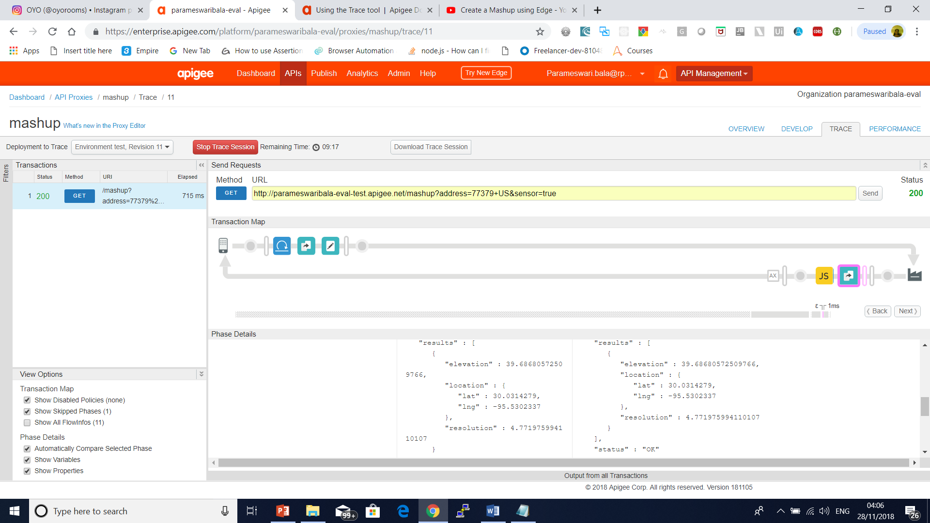
Mashup

Slide 59
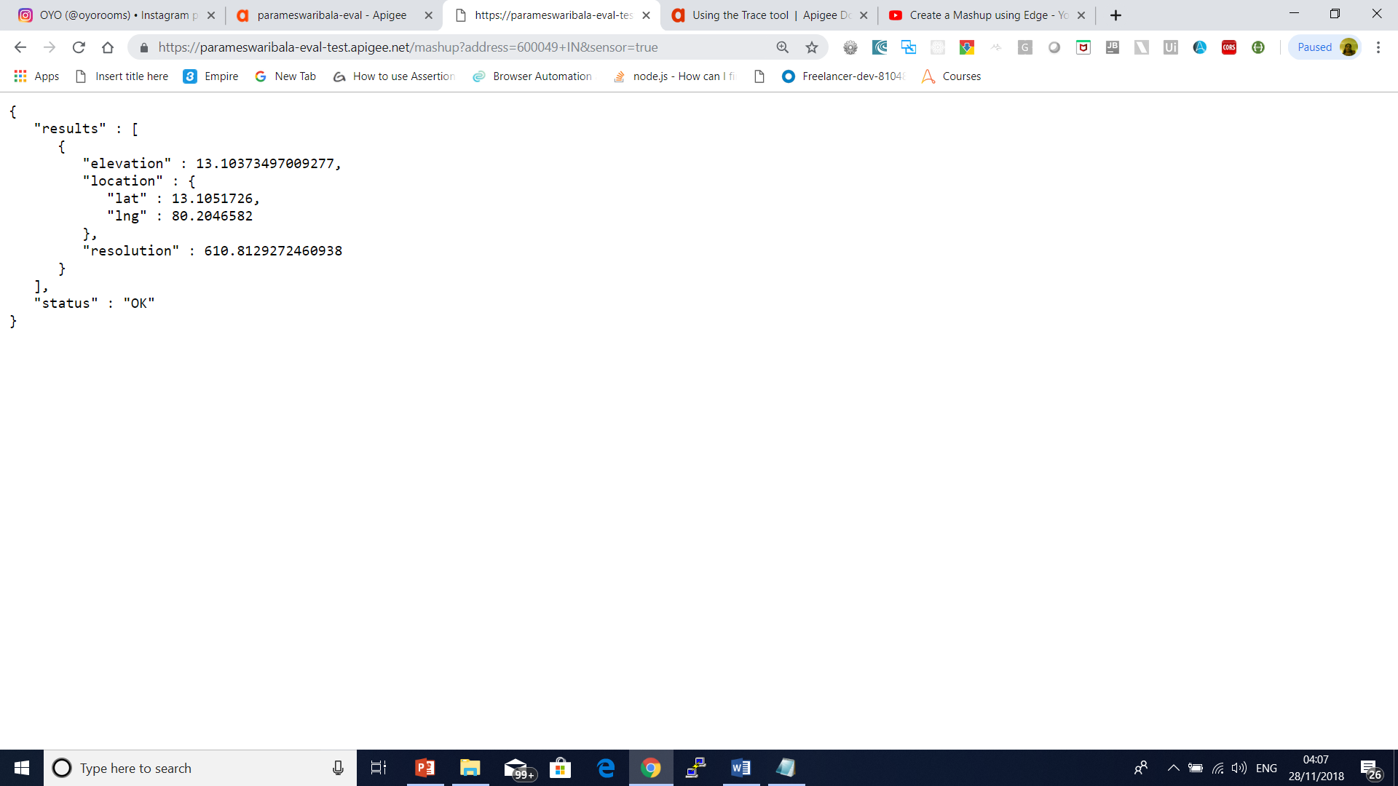
Mashup

Slide 60
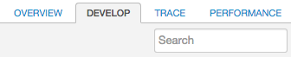
Add the Spike Arrest policy to your API
In the editor for the new API proxy, click the Develop tab.
(If you're not in the API proxy editor, select APIs > API Proxies > helloworld_policies in the management UI menu.)
The API Proxy Editor lets you see the structure of your API proxy and configure its flow.
The editor presents a visual representation of your proxy's request and response message flow as well as an editable display of the underlying XML that defines the proxy.
In the left Navigator pane, click PreFlow under Proxy Endpoints > default.
Click the top +Step button, corresponding to the Request PreFlow.
This displays a categorized list of all the policies you can create.

Slide 61
Debugging
Trace is a tool for troubleshooting and monitoring API proxies running on Apigee Edge.
Trace lets you probe the details of each step through an API proxy flow.

Slide 62
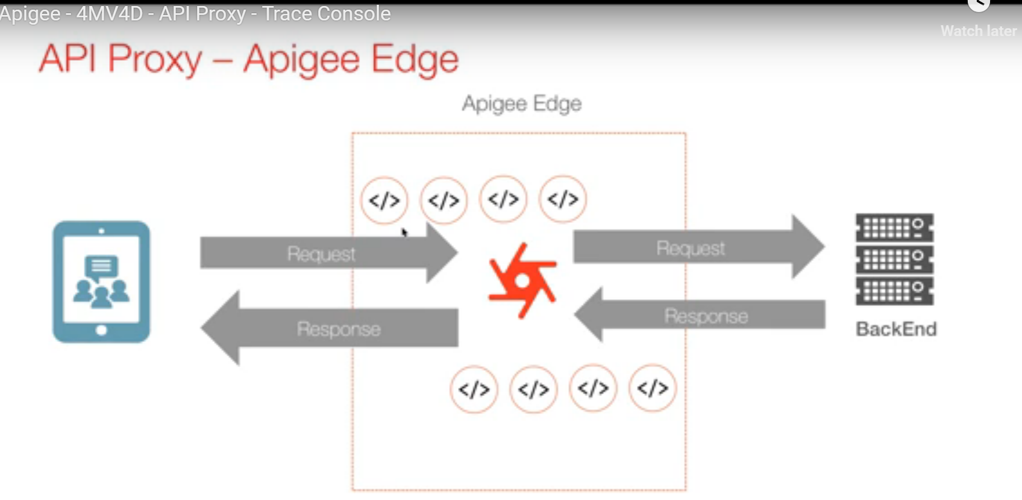
Debugging

Slide 63
How to use Trace
Trace is simple to use. You start a trace session, then make an API call to the Edge platform, and read the results.
Navigate to the Trace tool:
In the New Edge UI: Select Develop > API Proxies in the left navigation bar.
In the Edge Classic UI: Select APIs > API Proxies in the top navigation bar.
Select an API proxy from the API Proxies page.
Be sure the API you wish to trace is deployed.
Click Trace to go to the Trace tool view.
Use the Deployment to Trace dropdown menu to select which deployment environment and proxy revision you wish to trace.
Click Start Trace Session. When the Trace session is active, the API proxy records details of each step in the processing pipeline. While the Trace session is running, messages and contextual data are captured from live traffic.

Slide 64
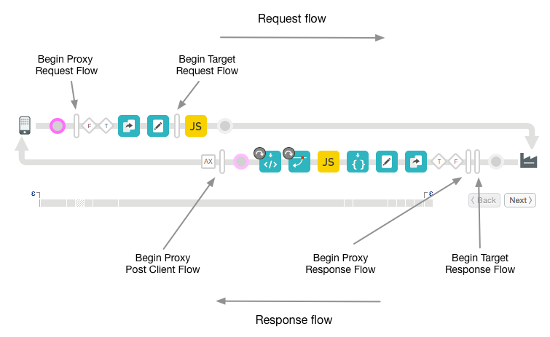
How to use Trace

Slide 65
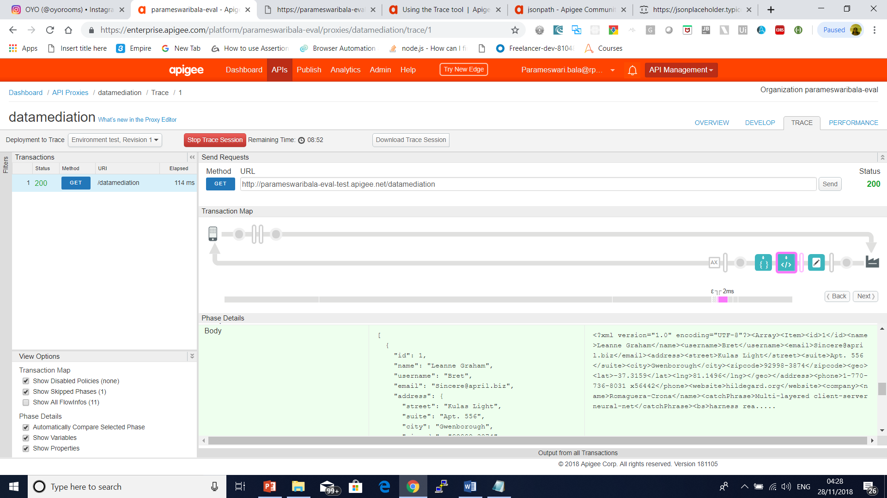
Debugging
Json to xml

Slide 66
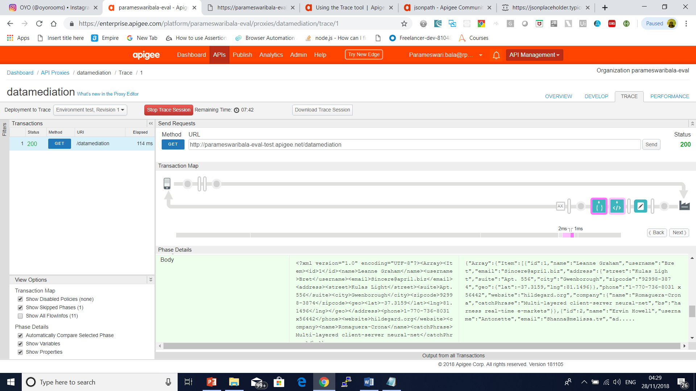
Debugging
Xml to json

Slide 67
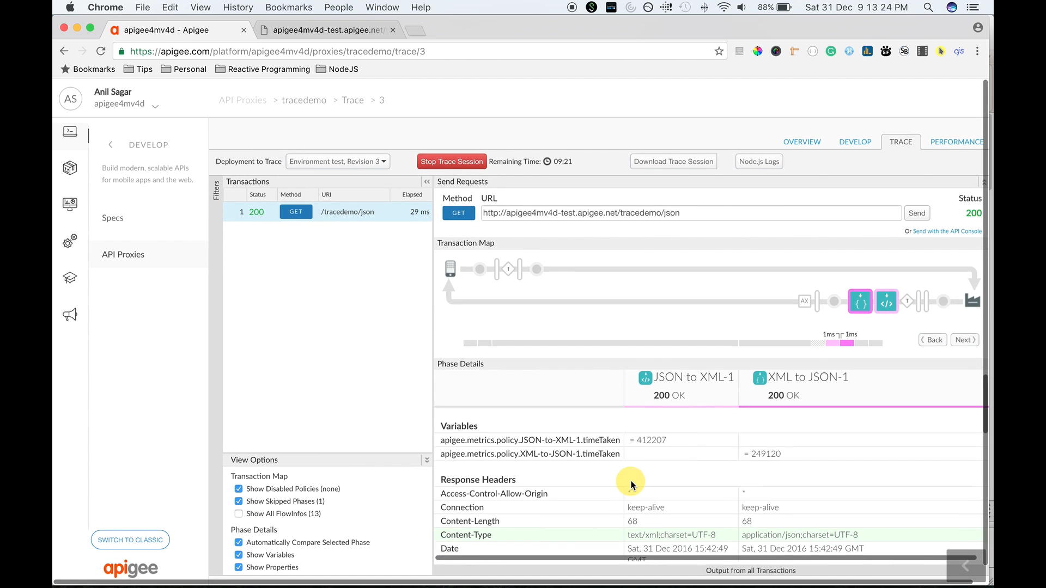
Debugging

Slide 68
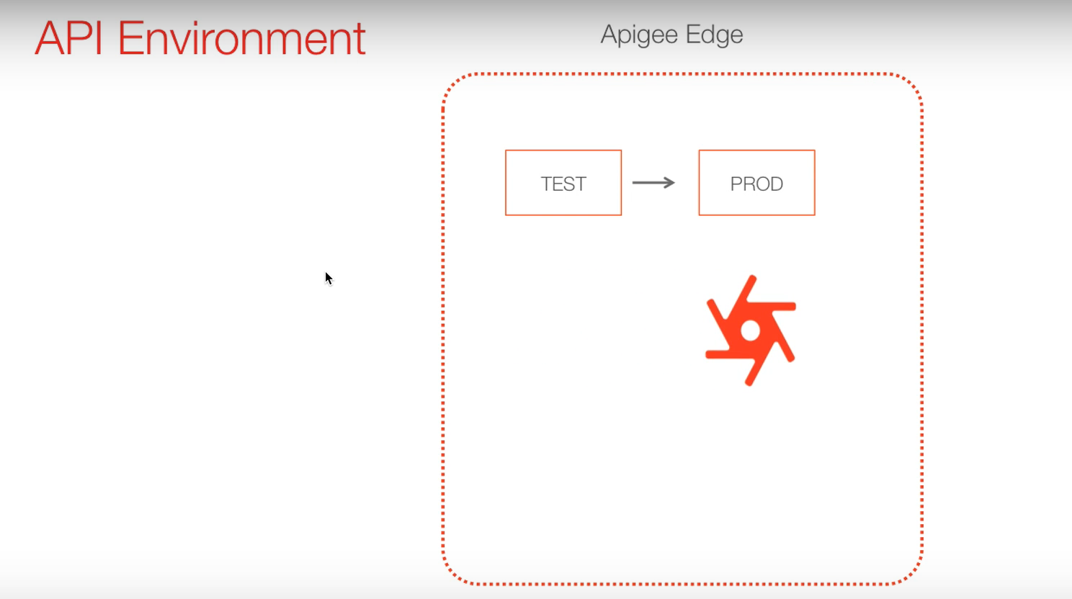
Environment Configuration

Slide 69
Creating an Organization, Environment, and Virtual Host
Creating and editing caches
In the management UI, click the APIs menu, then click Environment Configuration.
Select the environment for which you want to configure caches, such as test or prod.
Go to the Caches tab.
Click Edit.
Under Caches, at the right side, click the +Cache button to add a new cache.

Slide 70
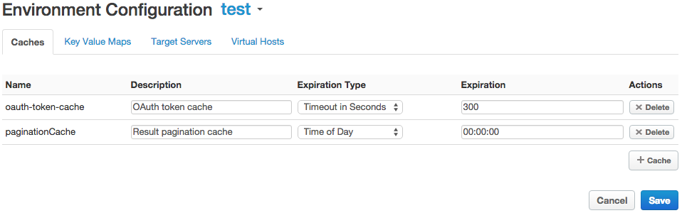
Creating an Organization, Environment, and Virtual Host

Slide 71
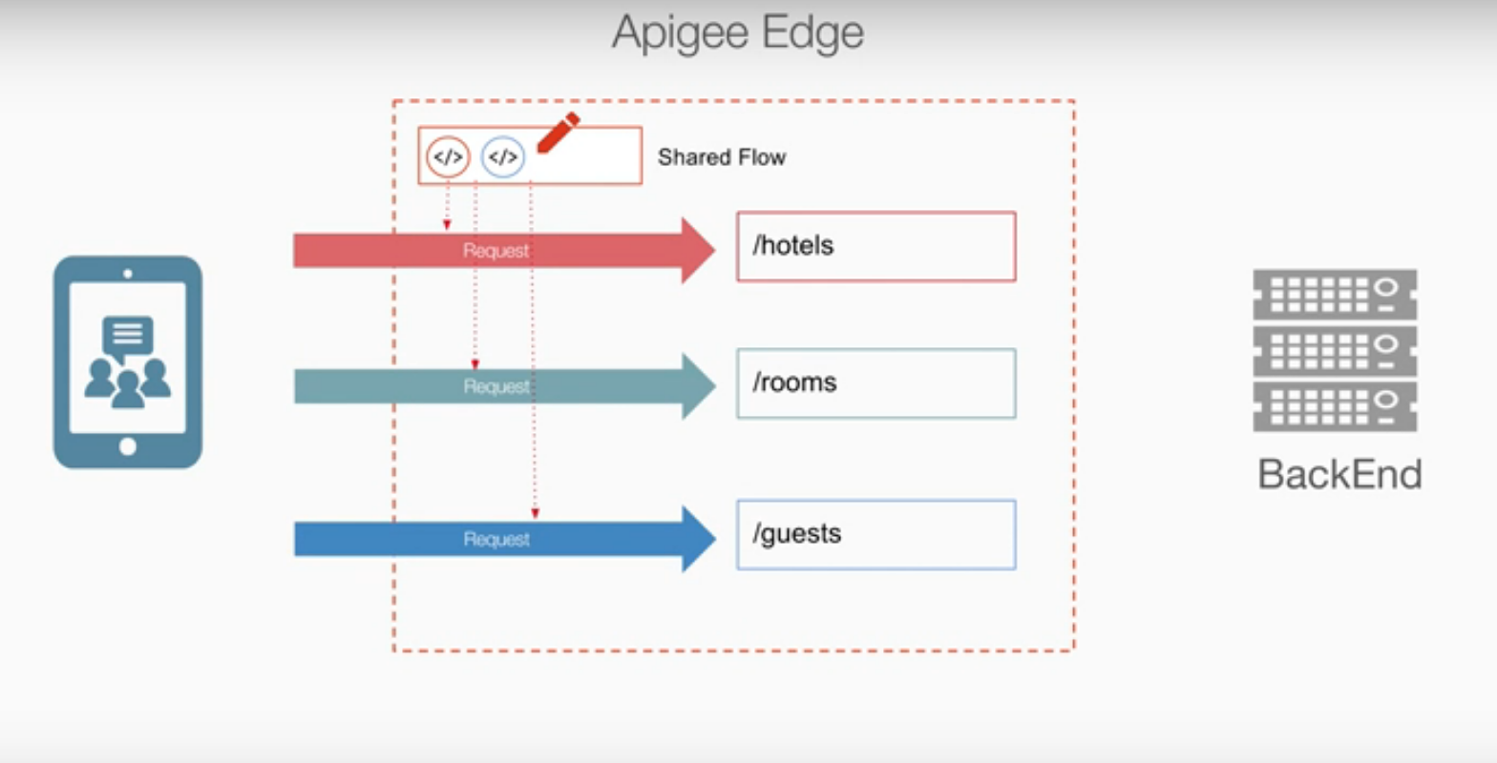
Creating an Organization, Environment, and Virtual Host
Shared Flows

Slide 72
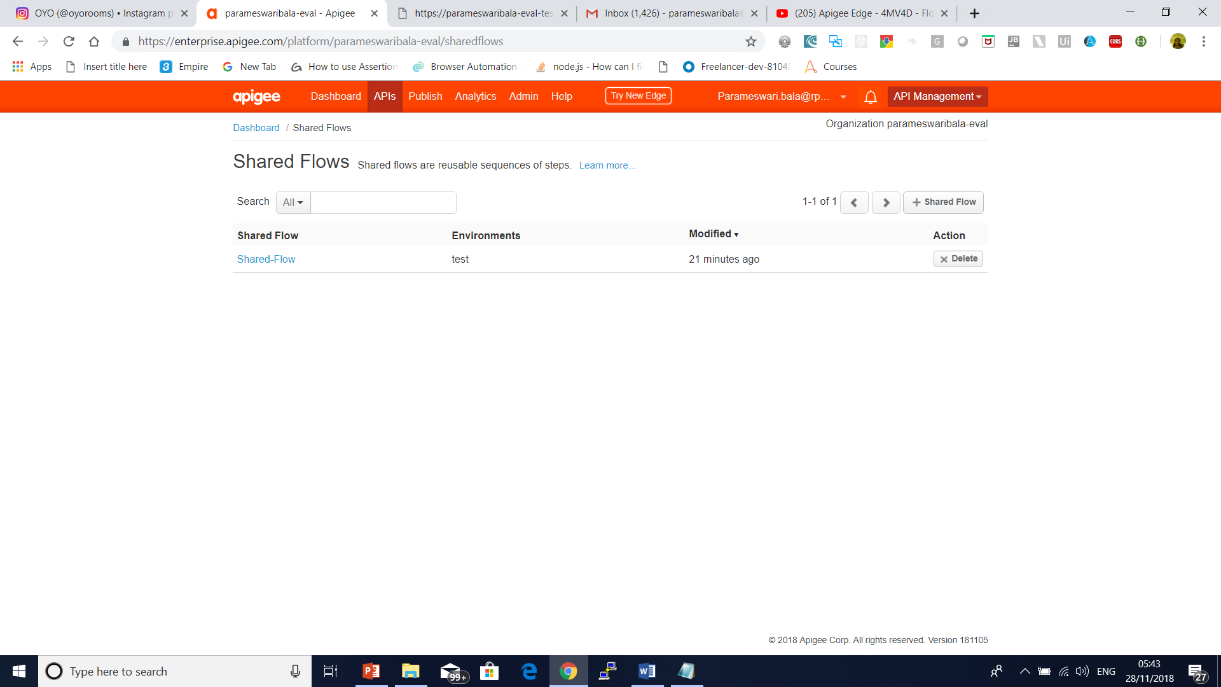
Creating an Organization, Environment, and Virtual Host

Slide 73

Creating an Organization, Environment, and Virtual Host
Shared Flows

Slide 74
Creating an Organization, Environment, and Virtual Host
Shared Flows

Slide 75

Creating an Organization, Environment, and Virtual Host
Shared Flows

Slide 76

Creating an Organization, Environment, and Virtual Host

Slide 77

Creating an Organization, Environment, and Virtual Host

Slide 78

Creating an Organization, Environment, and Virtual Host

Slide 79
Creating an Organization, Environment, and Virtual Host

Slide 80

Creating an Organization, Environment, and Virtual Host

Slide 81

Creating an Organization, Environment, and Virtual Host
Flow Hooks

Slide 82

Creating an Organization, Environment, and Virtual Host
Flow Hooks

Slide 83

Creating an Organization, Environment, and Virtual Host
Flow Hooks
Event though we have not added any policy automatically comes from flow hook

Slide 84
Creating an Organization, Environment, and Virtual Host
Flow Hooks

Slide 85

Add the Spike Arrest policy to your API

Slide 86

Add the Spike Arrest policy to your API

Slide 87

Add the Spike Arrest policy to your API

Slide 88

Add the Spike Arrest policy to your API
In the XML for the policy, change the value of the <Rate> element to 1pm (which translates into roughly 2 requests allowed every 60 seconds in the cloud).

Slide 89
Add the Spike Arrest policy to your API
Execute the curl command (or refresh the browser window) two or three more times within one minute, and notice that you get the following message because you exceeded the rate limit of the policy:
{
"fault": {
"faultstring":"Spike arrest violation. Allowed rate : 1pm",
"detail": {
"errorcode":"policies.ratelimit.SpikeArrestViolation"}
}
}
If you try making more calls within a minute, you should continue to get the fault message.

Slide 90
Add the Spike Arrest policy to your API
Edit your policy to set the <Rate> limit to 15pm (which translates into roughly 2 calls allowed every 4 seconds in the cloud), and then save the API proxy.
Run the curl command or refresh the browser repeatedly (cURL is faster).
Notice that if you make one or two calls within 4-second intervals, your calls succeed.
If you make the calls quickly, more than two in within 4 seconds, you should get the fault. But after each 4-second interval you can continue making calls, as opposed to being blocked out for an entire minute (with the 1pm setting).

Slide 91

Caching

Slide 92

Caching

Slide 93

Caching
Cached Data

Slide 94
Cache Parameters
<PopulateCache name="token-cache">
<!-- The cache to write to. -->
<CacheResource>mycache</CacheResource>
<!-- The source of the data, a variable containing the value. -->
<Source>twitter-translate.apiAccessToken</Source>
<!-- An enumeration representing a prefix for namespace scope. -->
<Scope>Exclusive</Scope>
<!-- A unique pointer (a flow variable value) to the data. Use this later to retrieve it. -->
<CacheKey>
<KeyFragment>apiAccessToken</KeyFragment>
<KeyFragment ref="request.queryparam.client_id"></KeyFragment>
</CacheKey>
<!-- Entries placed into the cache with this policy will expire after 600 seconds. -->
<ExpirySettings>
<TimeoutInSec>600</TimeoutInSec>
</ExpirySettings>
</PopulateCache>

Slide 95

Caching
Cached Data

Slide 96

Caching
Cached Data

Slide 97

Caching
Cached Data

Slide 98
Questions

Slide 99

Module Summary
Thank you
Lambdas
Stream API
Base 64
Nashorn
Reflection
Date Time API
Repeated Annotations
JDBC Improvements

